Slide 1
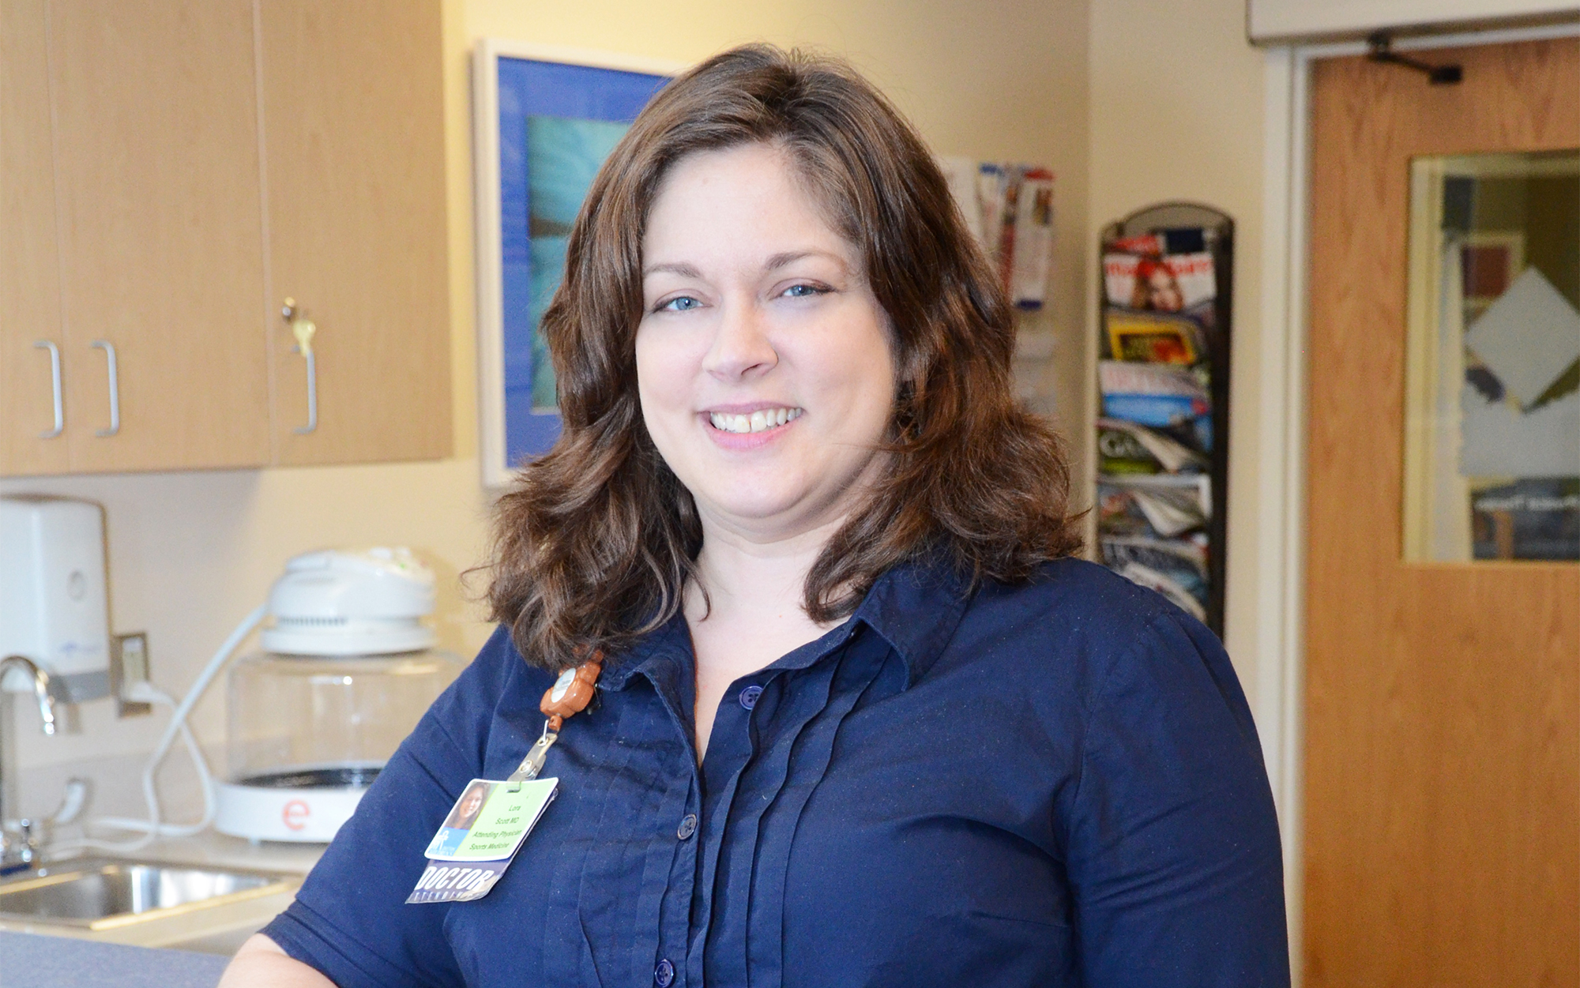
Lora Scott, MD
Bio:
Medical director of sports medicine at Dayton Children's
Medical degree from the St. Louis University School of Medicine
Residency - Pediatrics at University of South Florida, Tampa, FL
“I chose my specialty because I wanted to help children safely participate in exercise and activity, while managing their illnesses and injuries appropriately.”

Slide 2
Early Sports Specialization
Dr. Lora Scott
Sports Medicine Program Director

Slide 3
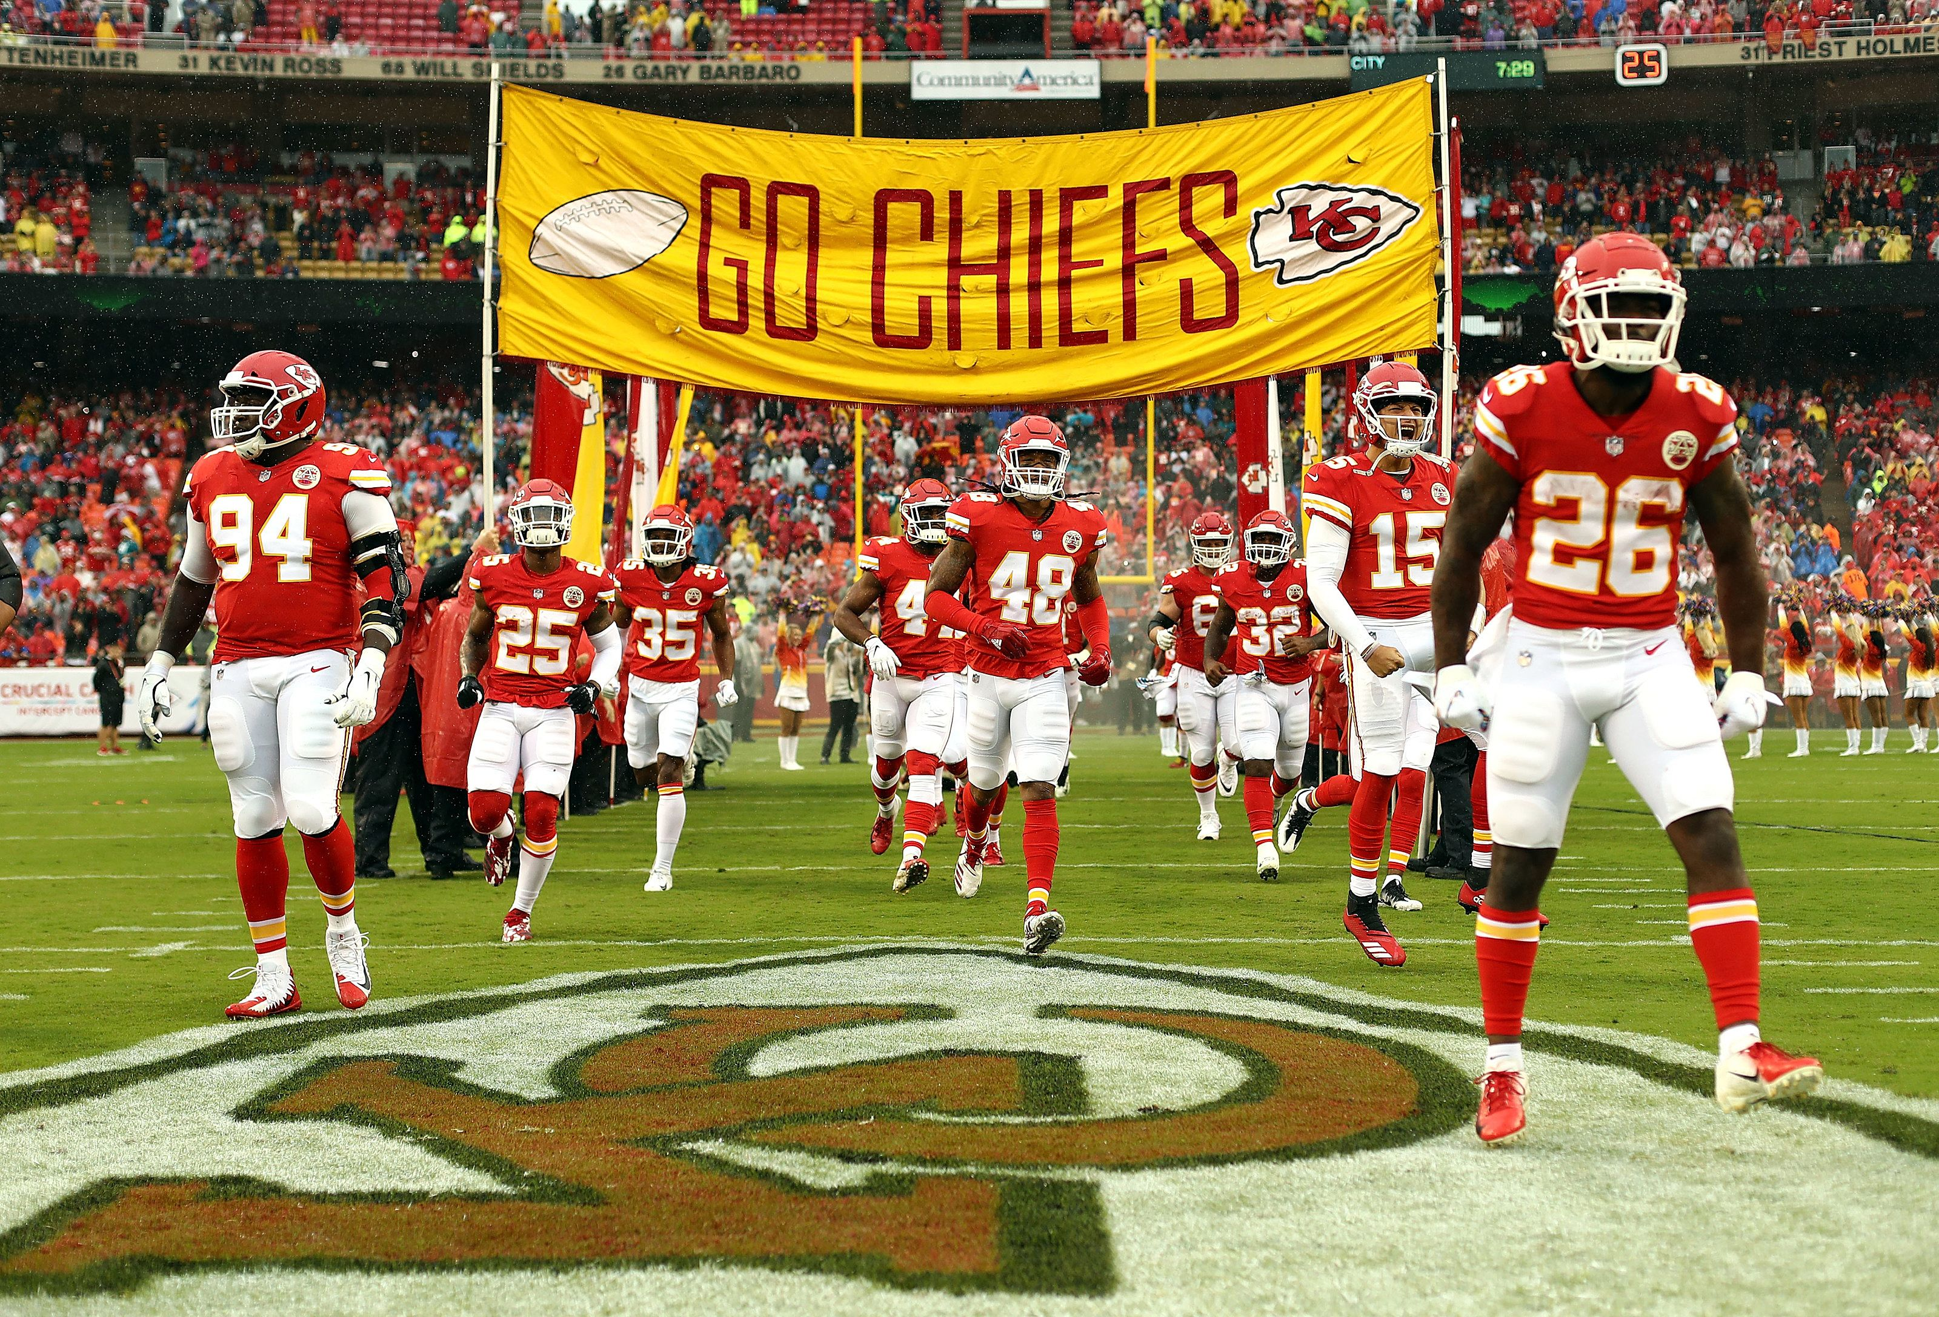
Disclosures
No financial disclosures.

Slide 4
What would you do?
Your child is a 15yom, small for his age late-bloomer who is entering the 10th grade. He is trying to decide what sport to play this fall. He is a promising baseball player. He also has experience in flag football, soccer, and track. He played tackle football for the first time last year as 3rd-string quarterback for the freshman team. He is debating between playing football again this year, or joining the select fall baseball league he was invited to join. Where do you send him?

Slide 5
I hope you said football

Slide 6
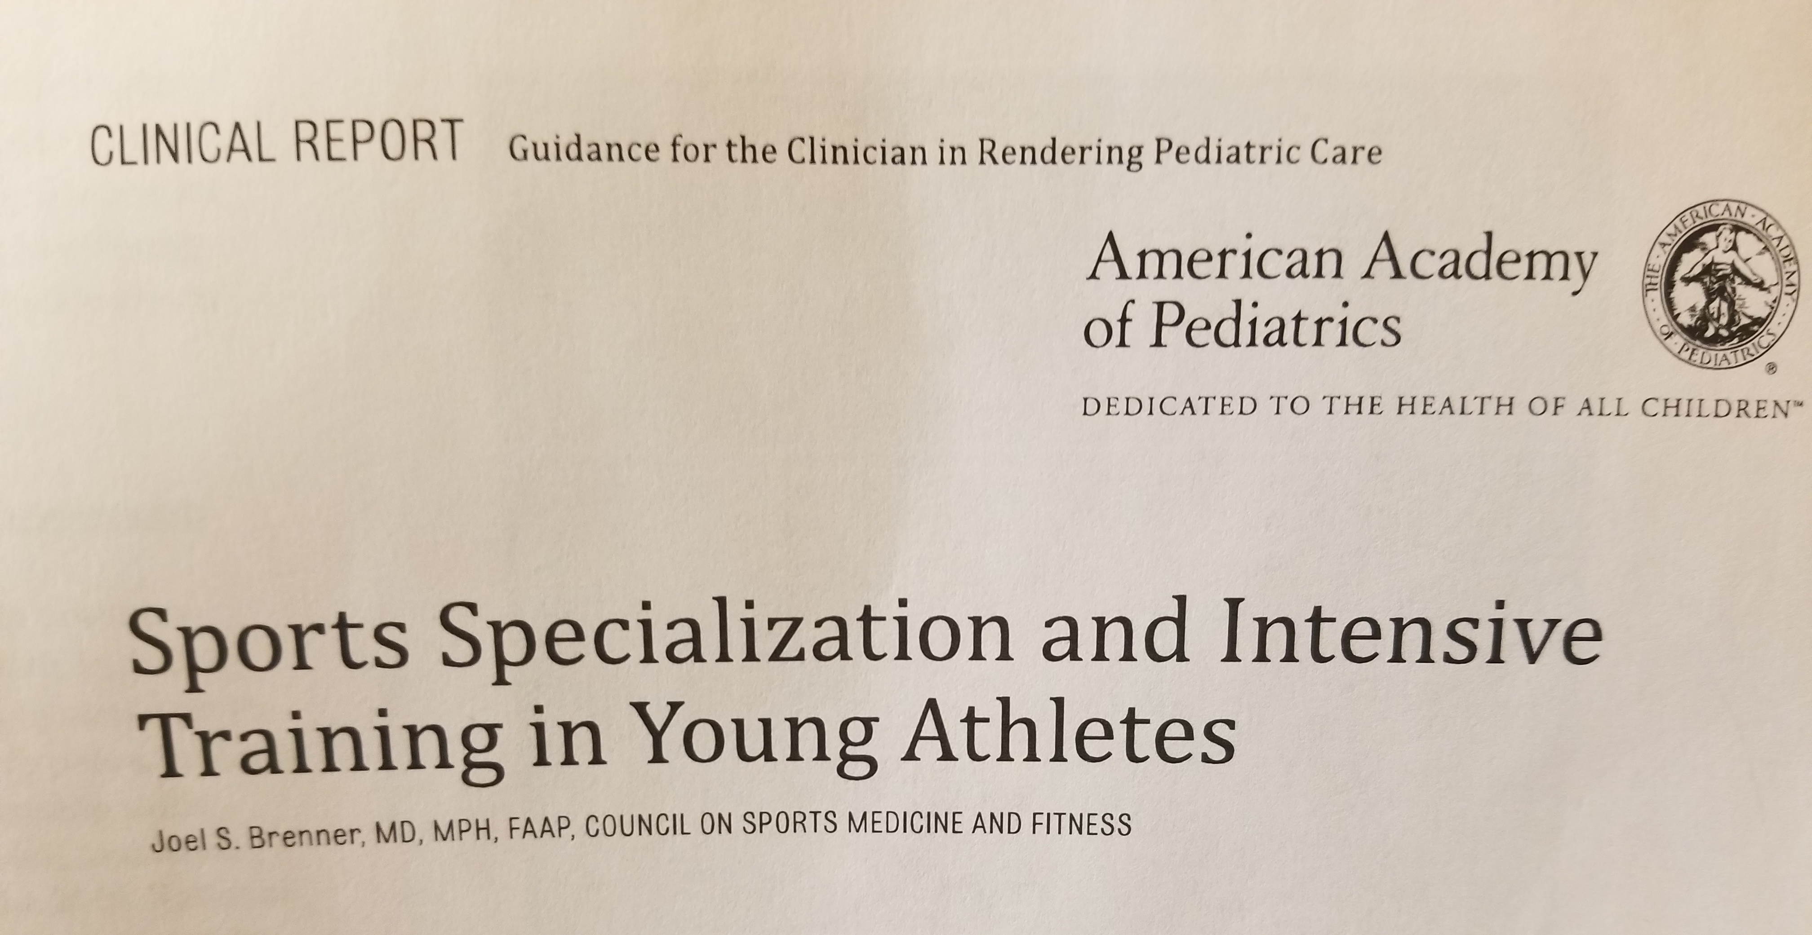
Brenner JS. “Sports Specialization and Intensive Training in Young Athletes.” Pediatrics. Vol 138:3. Sept 2016

Slide 7
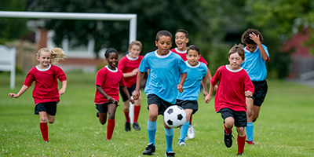
Benefits of youth sports
Skills needed for lifelong physical activity
Socialization
Teamwork
Leadership skills
Improved self-esteem
Having fun
My additions:
How to handle failure
How to handle pain

Slide 8
Evolution of Youth Sports
Former
Current
Pick-up neighborhood games
Organized by kids
Multisport athletes through high school
Play for school team
Minimal financial cost
Multiple leagues for various skill levels and ages
Organized by adults
Early sports specialization
Same sport year-round
Play for multiple teams
Thousands of dollars per child per year

Slide 10
The results
70% of athletes discontinue organized sports by age 13
Of the 30% who still play sports in high school…..
3-11% of those go on to compete in college
1% of high school athletes receive a sports scholarship
0.03 – 0.5% of high school athletes reach the professional level
At least 50% of injuries are related to overuse
Athletes in organized sports have >2:1 injury ratio compared to free play activities

Slide 11
Distribution of child activities – 40 years ago
Obese, not active
Active free play, variety of sports
Specialized, club sports

Slide 12
Today
Today’s talk
Obese, not active
Active free play, variety of sports
Specialized, club sports

Slide 13
Did adults ruin youth sports??
Sports specialization
Select and travel leagues start at age 7
Pressure athletes to commit to year-round participation, excluding participation in other sports
Promise early talent identification by coaches, media, sporting industry, colleges, and society in general
College recruitment starts in 6th grade.
The data
Only 1% of athletes get a college scholarship
Athletes who specialize before puberty have more injuries and quit at an earlier age

Slide 14
Early vs Late specialization
Early Specialization
Goal = produce elite athletes
Con = shorter athletic careers
Early Diversification
Goal = encourage lifelong health and fitness
Sample variety of sports
Include deliberate free play (pick-up games)
Pros: learn many sports skills, experience variety of social interactions with teammates and adults, less likely to drop out in the future

Slide 15
Pros of early diversification
Explore variety of sports
Physical, cognitive, social growth in a variety of positive environments
Develop intrinsic motivation
Learn fundamental movement skills which translate into multiple of sports
Can transfer skills to primary sport later
Require less deliberate practice at their chosen sport
Continue using skills in adulthood
Examples
Good jumpers can succeed in football, track, soccer, basketball, volleyball……..

Slide 16
Early diversification
Numerous surveys of elite athletes
Intense training delayed until late adolescence
Played multiple sports before specializing
Early diversification with late specialization
Division 1 NCAA athletes
More likely to be multi-sport athletes in high school
Their first organized sport is less often the one they play in college
Example – Tom Brady and Michael Jordan both focused on baseball first
2015 NFL Scouting Combine – 322 elite college athletes
87% were multi-sport athletes in high school

Slide 17
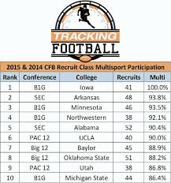
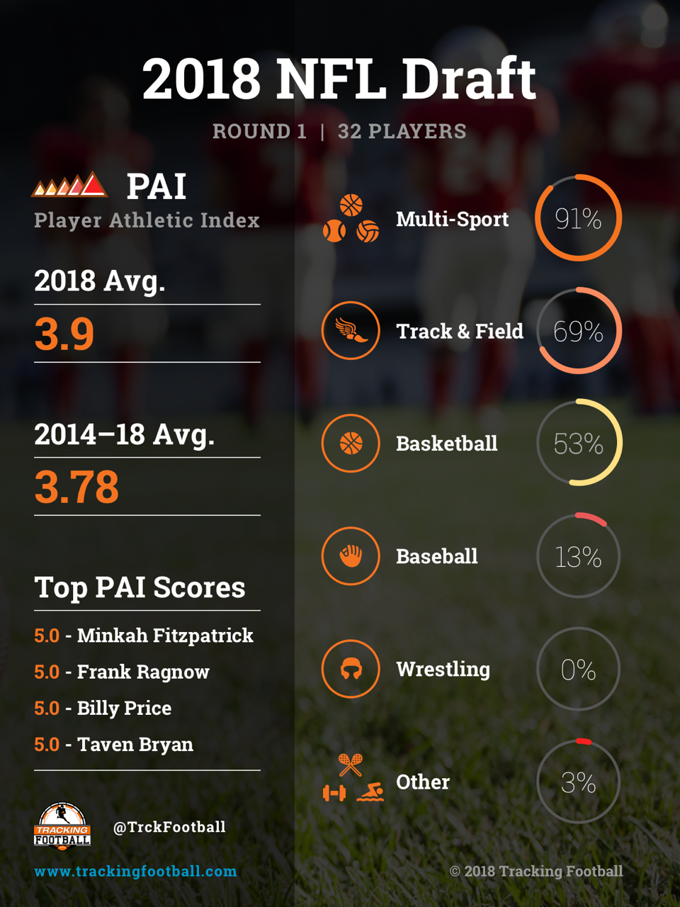

Slide 18
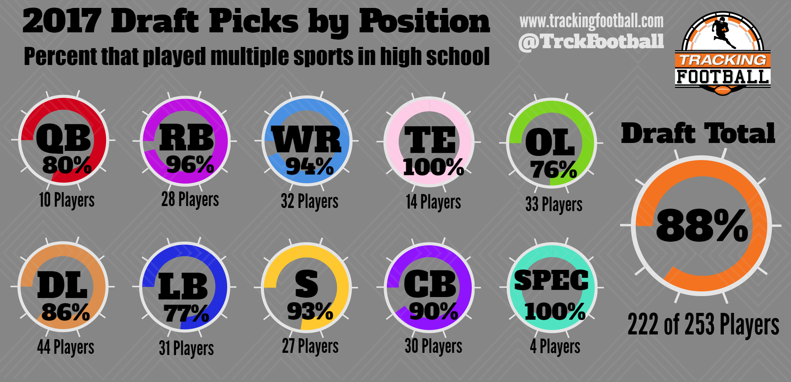
www.trackingfootball.com

Slide 19
Risks of Specialization
Social isolation
Dysfunctional family dynamics
Overdependence on others → increased risk of abuse
Loss of control over their free time
Behavioral development delay
Social maladaptive behaviors
Overuse injuries
Early retirement from sports (burnout, injury)
Mental illness – depression, anxiety
Financial
Missed opportunities to experience sports they would like as adults

Slide 20
Recognizing Burnout
Overtraining Syndrome
“a series of psychologic, physiologic, and hormonal changes that result in decreased sports performance”
Symptoms
chronic muscle or joint pain, personality changes, elevated resting HR, decreased sports performance, fatigue, lack of enthusiasm about sport, difficulty completing usual routines
Treatment / prevention
Sports diversification
Include age-appropriate games into practice
Allow 1-2 days per week off of organized sports (free play!!!)
Take 2-3 months time off organized sports per year
Teach athletes to listen to their bodies

Slide 21
When to specialize
After puberty, preferably age 16+
Minimizes risks of early specialization
Higher likelihood of athletic success
Have cognitive, physical, social, emotional, and motor skills necessary for more intense training
Have better understanding of risk:benefits of specialization

Slide 22
Exceptions to early specialization
Sports where peak performance occurs before full physical maturation
Figure skating, gymnastics, rhythmic gymnastics, diving
CONS
delayed puberty and maturation
Increased overuse injuries and female athlete triad

Slide 23
Recommended athlete development timeline
Long Term Athletic Development Programs (LTADs)
Developed in the 1990s
Counteract detrimental effects of early sports specialization
Master skills which are useful to a variety of sports
Agility, balance, coordination, speed (ABCs)
Schedule prophylactic breaks

Slide 24
LTAD Stages
Active Start
Ages 0-6
Gross motor skills
FUNdamental
Ages 6-10
Learn ABCs of athleticism through games, fun activities
Training to Train
Ages 10-14
Learn sport-specific skills
75% training, 25% competition
4. Training to Compete
Ages 13-18
50% technique and tactics
50% competition-specific training and competition
5. Training to Win
Ages 17+
Goal is to optimize performance
75% is competition-specific training and competition

Slide 25
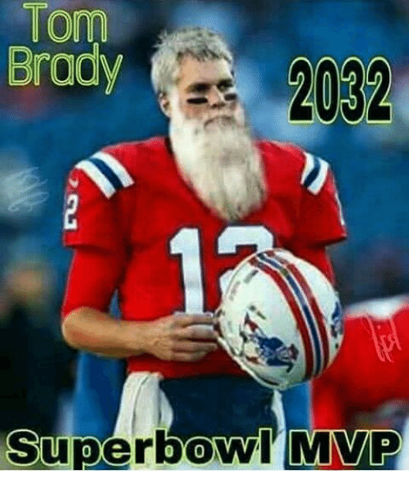
LTAD last stage
6. Retirement
Athlete stops competing permanently
May continue to exercise

Slide 26
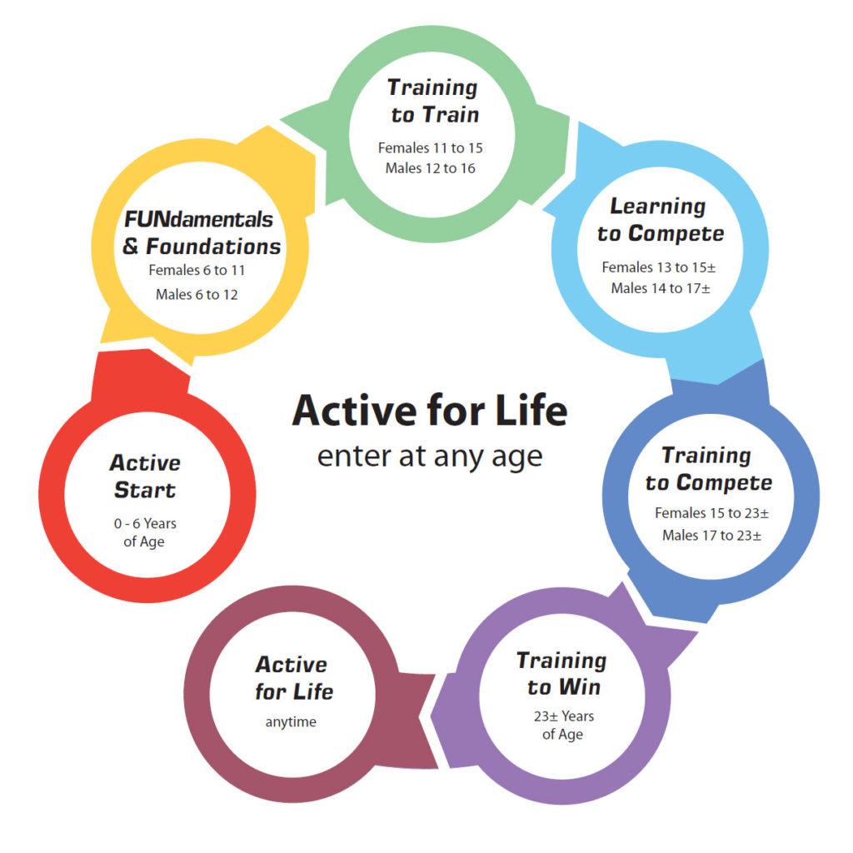

Slide 27
LTAD disadvantages
Based on empirical evidence
General plans, not specific to the individual athlete’s needs
Can be misused to further develop elite talent, rather than promoting activity for the majority
Example – single sport focus instead of diversification

Slide 28
Similar program used by USOC
Discover, Learn, and Play (ages 0-12)
Develop and Challenge (ages 10-16)
Train and Compete (ages 13-19)
Excel for High Performance OR Participate and Succeed (ages 15+)
Mentor and Thrive (lifetime)

Slide 29
Guiding Families
How much is too much?
Organized sports should be no more hours per week than a child’s age (until age 16)
Do not advance distance (running, swimming) more than 10% per week
Take 1-2 days off per week
Take 2-3 months off per year
Sports-Enhancement programs
Teach motor, social, and psychological skills
No proof that there is greater sports success than other activities which teach the same skills
Parents should monitor to ensure stated goals are being met

Slide 30
Guiding Families
Consider Goals
have fun, learn lifelong physical skills, psychosocial development
Focus on the child’s goals (having fun, socialization) rather than adult goals (scholarship, fulfilling parent’s unfulfilled dreams)
Early diversification
Don’t specialize until after puberty (ideal age is 15-16yo)
Those who insist on specializing early
Take 2-3 months off per year (1 month increments)
Play for 1 team at a time
1-2 days off per week

Slide 31
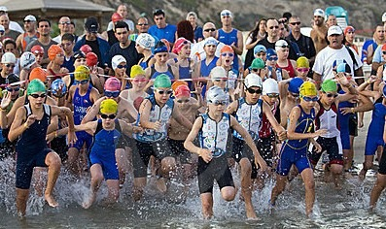
The unknowns
How much role does genetics play?
Endurance events
Triathlons
Marathons
Multi-day tournaments

Slide 32
What we do at my house
Ages 4 and 6
Active Start
FUNdamentals
Swimming lessons as a life skill
Outside free play time
Kicking, throwing, catching, batting, climbing, running, jumping, bike, scooter, neighbor’s parkhour stuff, neighbor’s trampoline
Hiking in Sugar Creek → agility, balance, coordination, how to fall down
Organized sports (6yo)
Rec league this spring for ??? (his pick)
Maybe karate (because he had fun at a karate birthday party and wants to try it)

Slide 33
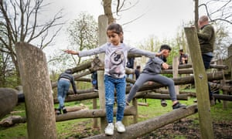
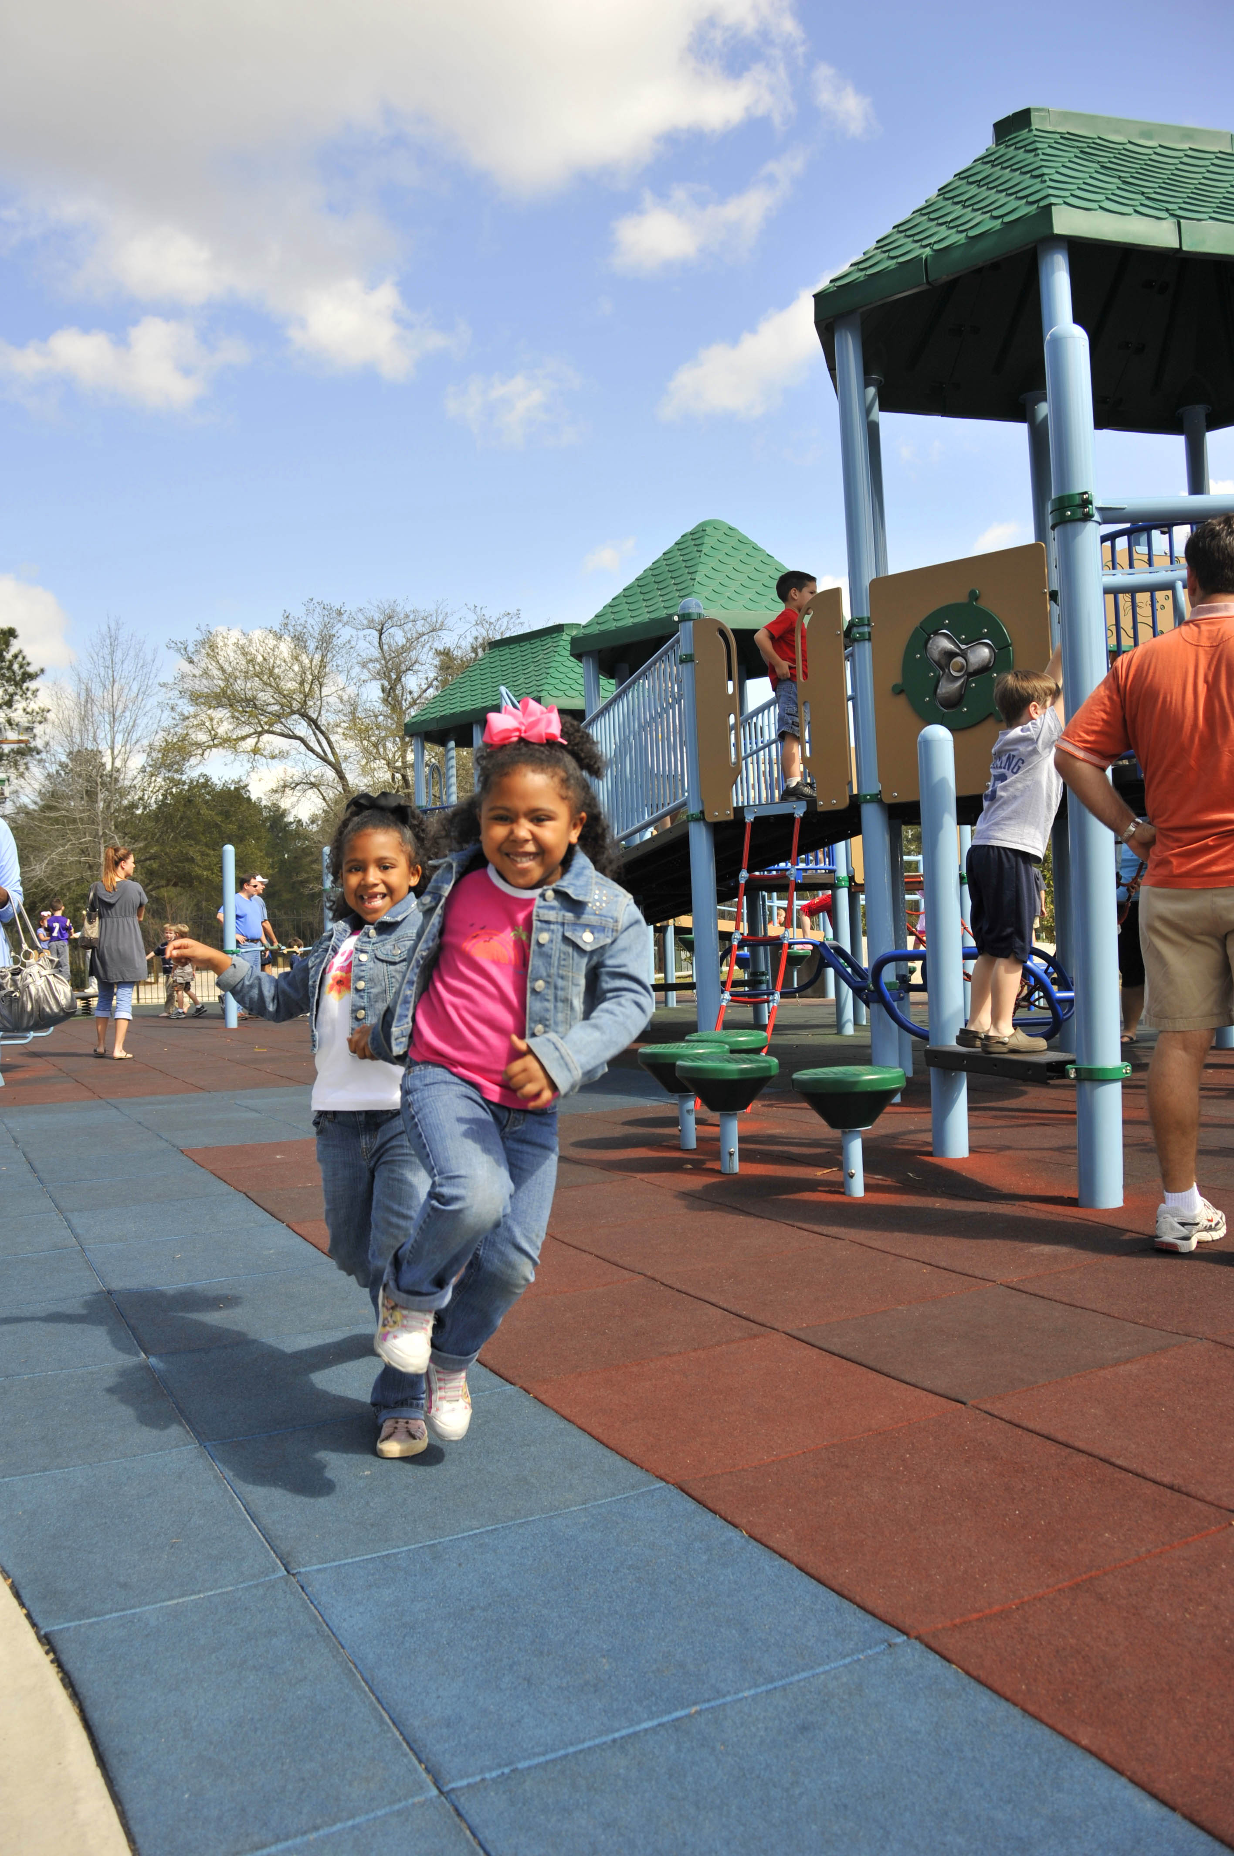
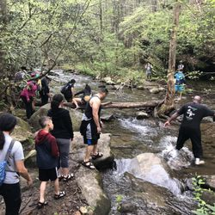
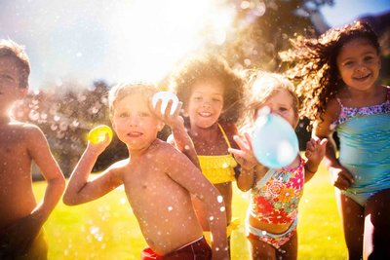
Athletic skills from free play

Slide 34
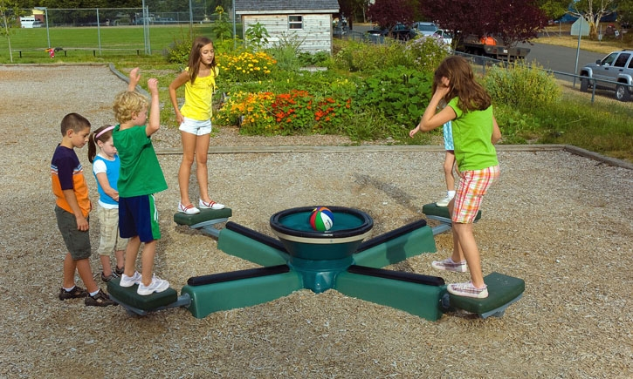
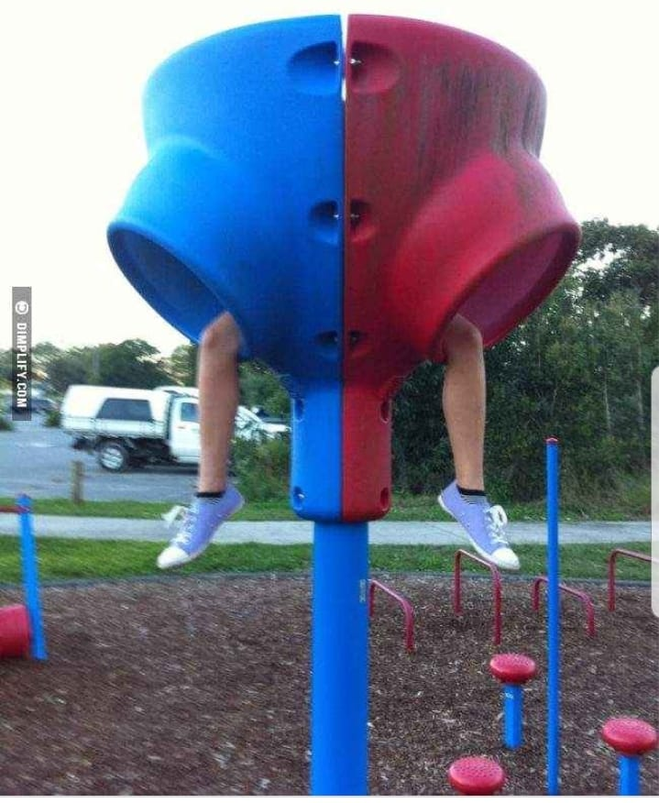
other skills from free play
Problem solving
Teamwork
Self-regulation

Slide 35
References
Bell DR, et al. Sport Specialization and Risk of Overuse Injuries: A Systematic Review with Meta-analysis.” Pediatrics. Vol 142:3. Aug 2018
Brenner, JS. “Overuse Injuries, Overtraining, and Burnout in Child and Adolescent Athletes.” Pediatrics. Vol 119:6. June 2007
Brenner JS. “Sports Specialization and Intensive Training in Young Athletes.” Pediatrics. Vol 138:3. Sept 2016

Slide 36
Questions??

