Slide 1
upper extremity overuse injuries in pediatric sports
pediatric orthopaedic symposium
September 27, 2019
Sarah Steward, MD

Slide 2
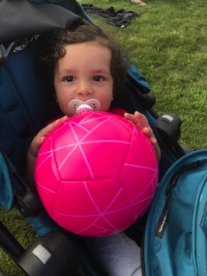
early sports specialization
Increasing frequency in children and adolescents
Attempt to achieve elite performance status
Attracting negative attention in medical and lay news
Possibility of an increased risk of acute and overuse injuries
Definition:
participation in one sport only
train >8 months/year

Slide 3
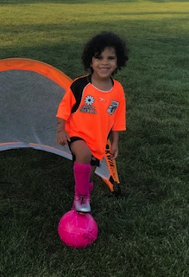
early sports specialization
Youth sports specialization and musculoskeletal injury: a systematic review of the literature
Fabricant PD et al. Phys Sportsmed. 2016 Sep;44(3):257-62.
3 studies included showed consistent results
All reported an increased risk of overuse injures (OR range: 1.27-4.0; P < 0.05)
Varied by sport and anatomic pathology
One study noted an increased rate of withdrawal from tennis matches (OR = 1.55, P < 0.05) in athletes who participated only in tennis compared to multisport athletes who competed in tennis.
The strength of recommendation grade for the current evidence against early sports specialization is "B" (recommendation based on limited-quality patient-oriented evidence).

Slide 4
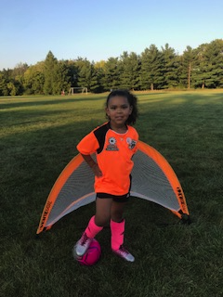
early sports specialization
Sport Specialization and Risk of Overuse Injuries: A Systematic Review With Meta-analysis.
Bell DR et al. Pediatrics. 2018 Sep;142(3)
Athletes with high specialization were at an increased risk of sustaining an overuse injury compared with athletes with low and moderate specialization.
Athletes with moderate specialization were at a higher risk of injury compared with athletes with low specialization.
5 studies included, only 4 in the meta-analysis
Conclusion: Sport specialization is associated with an increased risk of overuse musculoskeletal injuries (Strength of Recommendation Taxonomy grade: B)

Slide 5
sports specialization and injury
The Association of Sport Specialization and Training Volume With Injury History in Youth Athletes.
Post EG et al. Am J Sports Med. 2017 May;45(6):1405-1412
Case-control study with 2011 patients, age 12-18 years
Highly specialized athletes were more likely to report a previous injury of any kind or an overuse injury in the previous year compared with athletes in the low specialization group.
independent of age, sex, and weekly organized sport volume
Athletes who played their primary sport more than 8 months of the year were more likely to report an upper or lower extremity overuse injury
Athletes who participated in their primary sport for more hours per week than their age were more likely to report an injury of any type

Slide 6
sports specialization and injury
Specialization patterns across various youth sports and relationship to injury risk.
Pasulka J et al. Phys Sportsmed. 2017 Sep;45(3):344-352.
Clinical case-control study, injured athletes age 7-18 years were compared to similarly aged uninjured
Of 1,190 athletes enrolled, 26% (313) were single-sport specialized
Athletes in individual sports may be more likely to specialize in a single sport than team sport athletes
proportion of single-sport specialized athletes in tennis (46.7%), gymnastics (30.1%), and dance (26.3%).
Single-sport specialized athletes in individual sports (compared to specialized in team sports):
Specialize at a younger age (11.2 ± 2.4 vs. 12.0 ± 2.7, p = 0.05)
gymnastics (8.9 ± 1.7), dance (10.8 ± 3.0), and soccer (10.9 ± 2.4)
Reported higher training volumes (11.8 vs. 10.3 h/week, p = 0.04)
Higher proportion of overuse injuries (44.3% vs 32.2%, OR = 1.67, p = 0.037) and serious overuse injuries (23.4% vs 11.6%, OR = 2.38, p = 0.011)
Lower proportion of acute injuries (28.8% vs 13.8%, OR = 0.37, p = 0.001)

Slide 7
sports specialization
Socioeconomic Factors for Sports Specialization and Injury in Youth Athletes.
Jayanthi NA et al. Sports Health. 2018 Jul/Aug;10(4):303-310
Cohort study of 1139 patients, 7-18 yrs old
High-SES athletes compared to low-SES athletes:
higher rates of sports specialization
more hours per week playing organized sports
higher ratio of weekly hours in organized sports to free play
greater participation in individual sports
= more serious overuse injuries

Slide 8
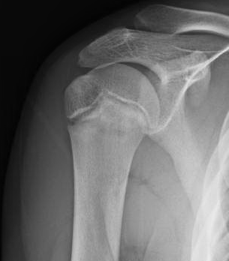
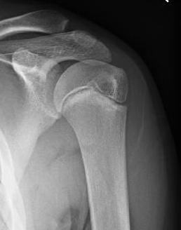
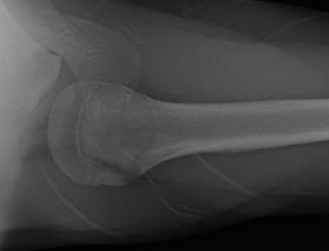
16 yo m pitcher with right shoulder pain for 2 weeks
Notes:
16 yo baseball pitcher, recent increase in intensity, loss of velocity with pain.

Slide 9
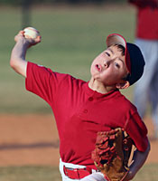
little league shoulder
Proximal humeral growth plate injury
Typically 10-16 yo
Overhead athletes: Baseball, Tennis
Repetitive microtrauma/traction to growth plate
Repeated high load torque in a rapidly growing child athlete

Slide 10
little league shoulder
Improper mechanics
Lack of muscle strength and endurance of scapular stabilizer and rotator cuff muscles
Playing year round or more than one league in a season
Not enough rest between throwing sessions
Throwing curve ball or slider before growth plates have closed
Too much throwing!!!!

Slide 11
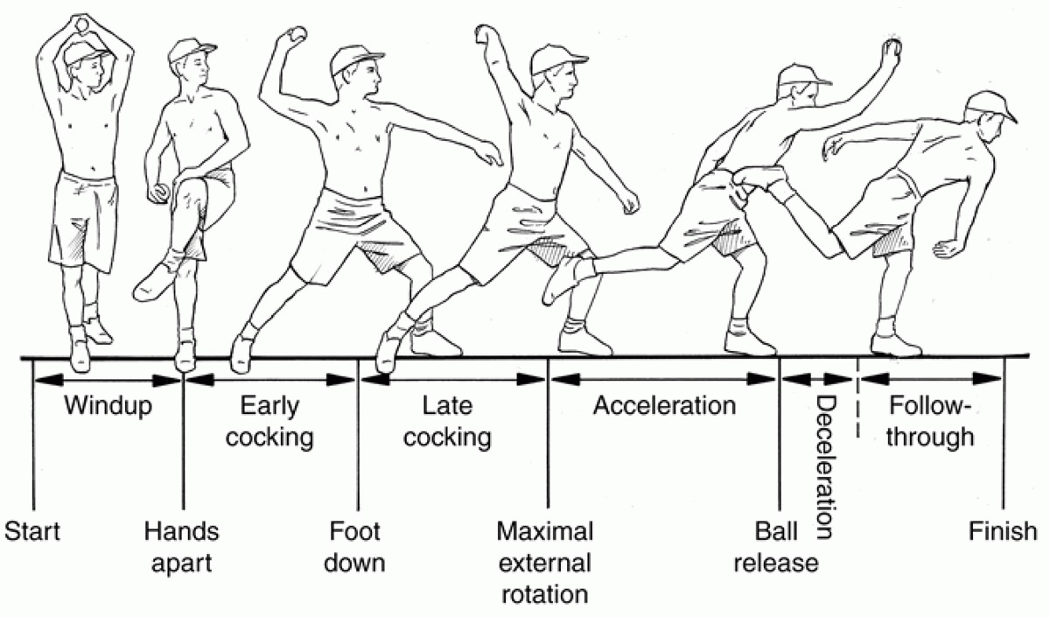
little league shoulder- history
Generalized shoulder pain with throwing/overhead activities
Late cocking or deceleration phase
Change in level of activity
Increased throwing
Loss of velocity and/or control
Rest pain later on

Slide 12
little league shoulder - exam
Painful and/or limited range of motion
External rotation
Pain with resisted elevation of the shoulder
Pain with extreme of motion in any direction
Tenderness over proximal humerus physis

Slide 13
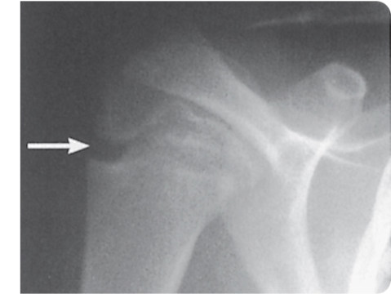
little league shoulder x-rays
Widened, irregular proximal physis
May be normal!
Occasionally can have formal fracture or separation
Likely caused by rotary torque in cocking/acceleration phases

Slide 14
little league shoulder - treatment
CESSATION OF THROWING ACTIVITIES!
Usually 2-3 months
Physical therapy program
Rotator cuff strengthening
Progressive throwing program
Improve mechanics

Slide 15
results
With proper rehab and pitch monitoring, 91% go back to previous level of activity -Kocher et al, 2000 Sports Med
Long-term problems are rare
High rate of remodeling of proximal humerus
Premature growth arrest or angular deformity
Salter-Harris fracture

Slide 16
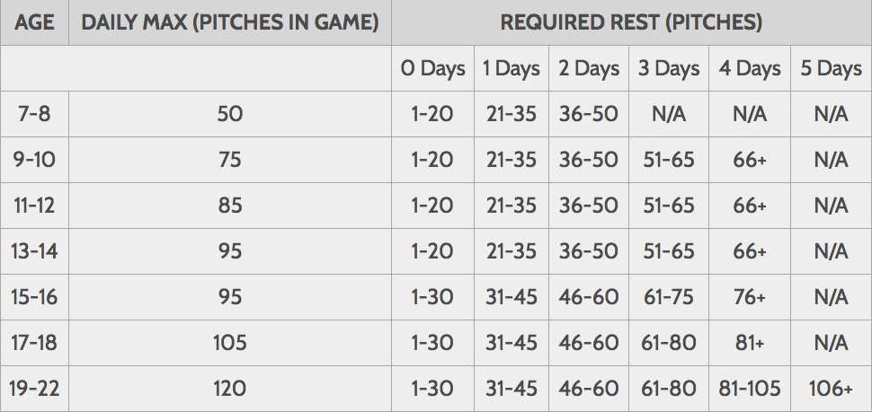
prevention
Pitching Recommendations for the Young Baseball Player
Age Maximum Pitches Maximum Games
Per Game per Week
8-10 52 ± 15 2 ± 0.6
11-12 68 ± 18 2 ± 0.6
13-14 76 ± 16 2 ± 0.4
15-16 91 ± 16 2 ± 0.6
17-18 106 ± 16 2 ± 0.6
(Reproduced from Pasque CB, McGinnis DW, Griffin LY: Shoulder, in Sullivan JA, Anderson ST [eds]: Care of the Young Athlete. Rosemont, IL, American Academy of Orthopaedic Surgeons, 2000, p 347.)

Slide 17
rotator cuff tendonitis/impingement
Adolescent overhead athletes
baseball, swimming, tennis
Tendinitis or strains of the rotator cuff
Result of outlet impingement, cumulative tensile overload, and instability associated with internal impingement

Slide 18
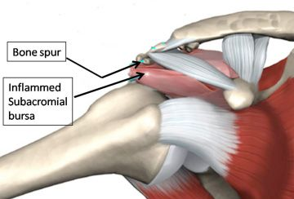
impingement
Internal and External
External
subacromial spur
AC hypertrophy
Type 3 acromion
Rare in adolescents

Slide 19
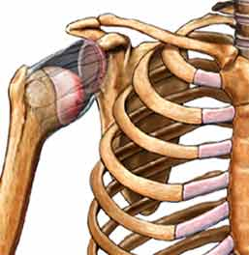
impingement
Internal
Multidirectional instability
Loose shoulder results in excessive translation of humeral head against RC

Slide 20
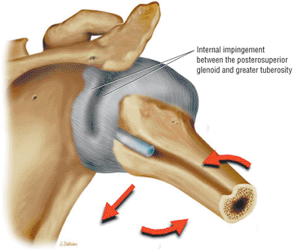
impingement
Internal
Abutment of the supraspinatus tendon/greater tuberosity with the posterosuperior glenoid rim/labrum
Extremes of abduction and external rotation
Late cocking phase of pitching
May lead to attritional injuries of the cuff and labrum
Thought to be due to posterior capsule contractures
Notes:
Repetitive tensile loading during the follow-through phase of throwing is the primary mechanism responsible for the development of the tight posteroinferior capsule. Large distraction forces must be resisted by the posteriorly rotated IGL during follow-through. (Based on
Burkhart SS, Morgan CD, Kibler WB. The disabled throwing shoulder: spectrum of pathology. Part I: Patho-anatomy and biomechanics. Arthroscopy 2003;19(4):404.

Slide 21
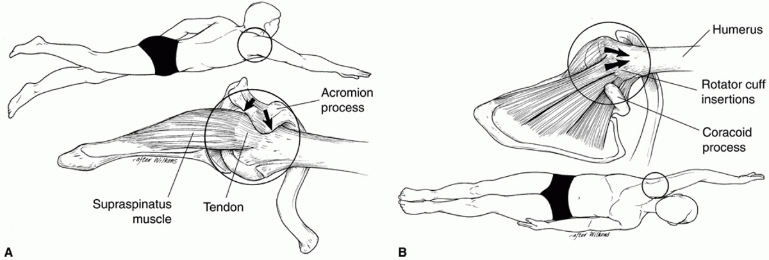
impingement
Swimmers subject their shoulders to excessive forces during
(A) the front crawl-stroke (cuff impingement)
(B) the backstroke (anterior capsular tension)
Notes:
) A color graphic illustrating hyperabduction and external rotation in the late cocking phase of throwing. In the late cocking phase of throwing the posterior band of the IGHL is bowstrung underneath the humeral head, causing a posterosuperior shift in the glenohumeral contact or rotation point. An acquired tight or contracted posterior band of the IGHL thus initiates the pathologic cascade (evident in abduction and external rotation causing GIRD). A posterosuperior shift of the humeral head causes increased shear and peel-back forces to the posterosuperior glenoid labrum, increased greater tuberosity clearance, and scapular protraction. (Based on
Burkhart SS, Morgan CD, Kibler WB. The disabled throwing shoulder: spectrum of pathology. Part I: Pathoanatomy and biomechanics. Arthroscopy 2003;19(4):404.

Slide 22
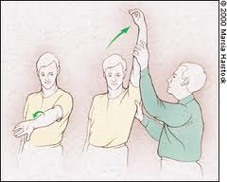
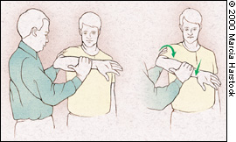
rotator cuff tendonitis/impingement
anterolateral shoulder pain that worsens with continued activity
mild stiffness and weakness in the involved extremity
Physical examination:
provocative impingement maneuvers
Neer impingement sign
Hawkins impingement sign
test ROM
⬇ internal rotation due to tight posterior capsule
Pain with resisted supraspinatus testing
significant weakness is not typically noted
Examination for concomitant glenohumeral instability
Notes:
Neer impingement sign is pain elicited by forcing the arm into a position of maximal forward elevation.
Hawkins impingement sign is pain elicited by forcible internal rotation with the arm forward elevated to 90°, which produces pain when the supraspinatus tendon impinges on the coracoacromial ligament or anterior acromion.

Slide 23
imaging for impingement
Standard radiographic studies
AP, outlet (scapular Y), and axillary views
Typically no marked osseous abnormalities.
MR arthrogram is the imaging study of choice for evaluation of rotator cuff
Tendonitis: Increased signal in the supraspinatus tendon/tendon insertion and inflammation in the subacromial space
partial or full thickness tears
not commonly seen in adolescents

Slide 24
rtc/impingement treatment
Rest, ice, NSAIDs
Physical therapy
Modalities to relieve pain
During the acute phase of tendinitis, exercises below shoulder level only to avoid rotator cuff outlet impingement.
Stretching for full ROM
posterior capsule stretching for limited internal rotation
Strengthening
rotator cuff and scapular stabilizers
correct underlying muscular imbalance
provide dynamic glenohumeral stability
prevent progression to partial or full-thickness tears that might require surgical intervention.
Throwing program
Usually, nonsurgical treatment allows gradual return to competition.
If not improving in 6-12-weeks, consider MRI

Slide 25
elbow ossification
Girls ossify earlier
Order
Capitellum
Radial head
Medial epicondyle
Trochlea
Olecranon
Lateral epicondyle

Slide 26
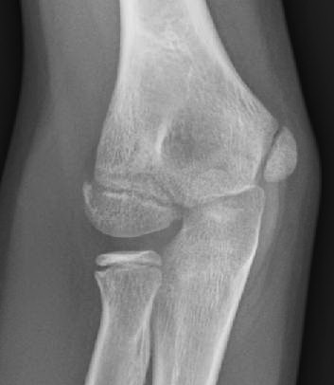
10 yo pitcher with medial elbow pain for 3 months
Notes:
10 yo Pitcher with medial elbow pain x3 months

Slide 27
little league elbow
Generic term for any injury to the elbow in a child with pain along the medial aspect of the proximal forearm or elbow
Late-cocking/early acceleration
Throwing curveballs or junk pitches
Infielder-type bent-elbow throw that involves a whipping mechanism to gain adequate speed
Younger patients – most likely apophysitis or an avulsion
Older adolescent - UCL sprain
Notes:
Valgus-hyperextension overload

Slide 28
little league elbow
Cause is repetitive microtrauma to physis
Trochlea or medial epicondyle
Pain can be on the compressed radial side of the joint as well as the distracted ulnar side
Progressive worsening of symptoms
Progressive loss of distance, accuracy, and speed

Slide 29
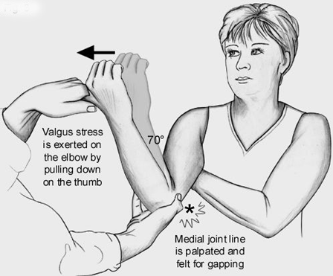
little league elbow exam
Seated patient
Point tenderness over the medial epicondyle and/or flexor mass
Valgus stress with the arm in varying degrees of flexion and extension – pain or instability
Milking maneuver
Increased carrying angle or flexion contracture if chronic

Slide 30
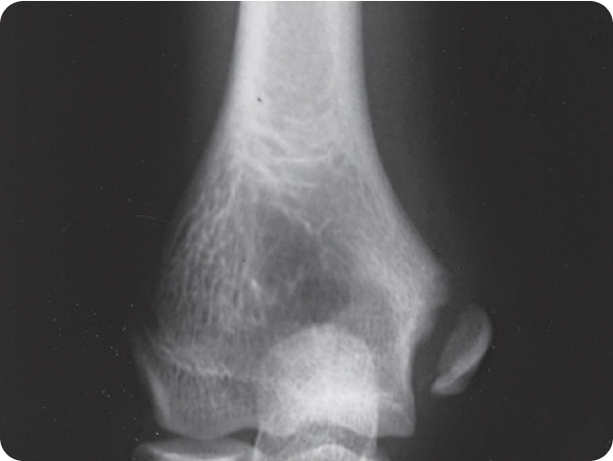
radiographic evaluation
AP/Lat Elbow Xrays
Comparison view of unaffected side
Irregular appearance of the medial epicondyle physis
Presence and degree of displacement
Fragmentation of the medial epicondyle, trochlea, olecranon, or capitellum.
Medial epicondyle hypertrophy or radial head hypertrophy may be present
Tachdjian's Pediatric Orthopaedics

Slide 31
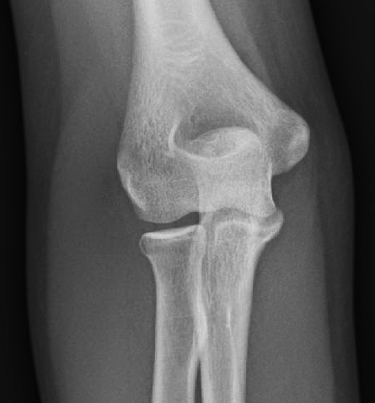
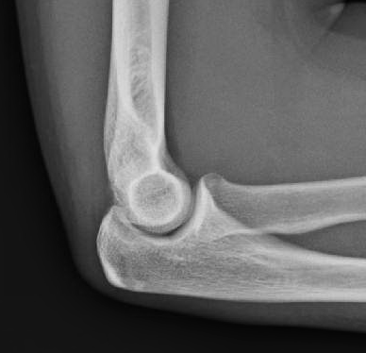
13 yo F year-round softball catcher with medial elbow pain
Same symptoms in older pt. with closed physes = UCL sprain
Notes:
13 yo F year-round softball catcher, medial elbow pain

Slide 32
little league elbow treatment
Best treatment is prevention through education
Throwing mechanics, pitch counts
Same as shoulder
Cessation of throwing 4-6 weeks
Progressive throwing program
May cast for 3-4 weeks for acute symptoms/fracture
Surgery only for avulsion fracture, fragmentation of medial epicondyle, or UCL tear

Slide 33
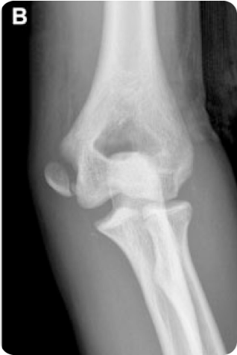
medial epicondyle fracture
Avulsion off distal humerus
Predisposition?
Casting (<5 mm displaced)
Surgery
rotated
displaced into joint
upper extremity athlete

Slide 34
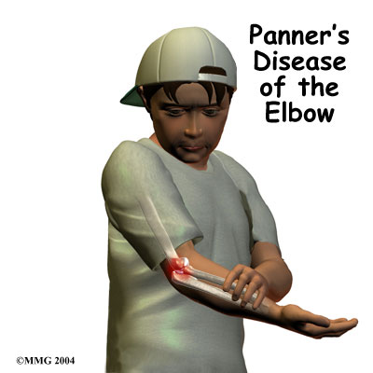
panner’s disease
Idiopathic, self-limiting osteonecrosis (loss of blood supply) to capitellum
Children under 10
Non-specific pain and stiffness about elbow
Worse with activity
Relatively benign course
Pain occurs during fragmentation of capitellar ossific nucleus
Normal capitellar growth resumes
No residual deformity or sequelae

Slide 35
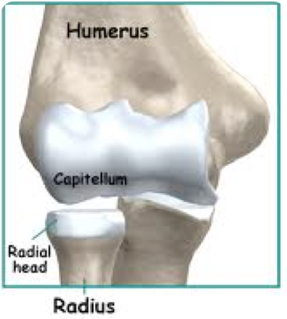
panner’s disease
Typically no history of injury
Overuse/overload from repetitive compression injuries
+/- Locking or Catching
Exam
Mild swelling/synovitis
Flexion contracture
Point tenderness
Maybe crepitus

Slide 36
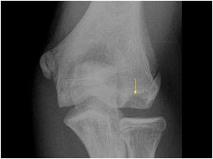
panner’s disease
Irregular, sclerotic capitellum
Treat with rest, NSAIDS, therapy for contractures, +/- immobilization for 3-6 weeks
Slow progression of activities over next 6-12 weeks
>90% success rate
May consider arthroscopic treatment if no improvement

Slide 37
ocd of the elbow
Older children
>10 years
Similar mechanism to Panner’s
Capitellum ossified by this age
Frequent cause of permament disability
Inability to participate in sports
Long-term: Arthritis

Slide 38
ocd of the elbow
Longer treatment than Panner’s
6-12 months before return to throwing or UE weight bearing sports
Based on classification:
I: Intact cartilage – Non-op, treat same as Panner’s, but maybe longer
II: Cartilage fracture – drilling +/- fixation
III: Loose bodies in joint – Loose body removal, drilling + fixation vs. Cartilage restoration

Slide 39
elbow injuries
An Epidemiological Comparison of Elbow Injuries Among United States High School Baseball and Softball Players, 2005-2006 Through 2014-2015.
Pytiak AV et al. Sports Health. 2018 Mar/Apr;10(2):119-124.
Elbow injuries in male baseball players occurred at rate of 0.92 per 10,000 AEs.
Elbow injuries in female softball players rate of 0.43 per 10,000 AEs.
A significantly greater proportion of elbow injuries in baseball were pitching-related compared with those from softball, 50.2% versus 11.0%
If all injuries occurring during pitching were removed from both sports, the difference in elbow injury rate for baseball and softball would no longer be significant (RR, 1.19; 95% CI, 0.88-1.62).
CONCLUSION: overhand pitching increases risk of elbow injury in high school athletes.

Slide 40
softball injuries
Epidemiology of Shoulder and Elbow Injuries Among US High School Softball Players, 2005-2006 Through 2016-2017
Oliver GD et al. Orthop J Sports Med. 2019 Sep; 7(9): 2325967119867428.
Overall shoulder injury rate was 1.14 per 10,000 AEs.*
Overall elbow injury rate was 0.41 per 10,000 AEs. *
Injuries to the shoulder were more likely to occur during competition as compared with practice
Half of the shoulder (50.4%) and elbow (48.9%) injuries were due to an overuse/chronic mechanism.
86.8% with shoulder injuries and 93.0% with elbow injuries returned to play within 21 days.*
Only 16.7% of shoulder injuries and 17.5% of elbow injuries were sustained by pitchers.*
*Far lower than high school baseball.

Slide 41
baseball injuries
Risk Factors for Baseball-Related Arm Injuries: A Systematic Review.
Agresta CE et al. Orthop J Sports Med. 2019 Feb 25;7(2):2325967119825557.
Deficits in preseason shoulder range of motion and strength
Pitching >100 innings in 1 year
Age 9 to 11 years
Pitcher or catcher
Training >16 hours per week
History of elbow pain

Slide 42
gymnast wrist
Distal Radius Physeal Injury
Young gymnasts with open physeal plates
High-impact forces and repetitive injury to the growth plate
Unlike adults, the immature wrist typically exhibits negative ulnar variance
higher distribution of load to the immature distal radius
Chronic compression can lead to growth arrest of the physis
Premature closure of the ulnar aspect.
Deformity with distal radius shifted ulnar and volar

Slide 43
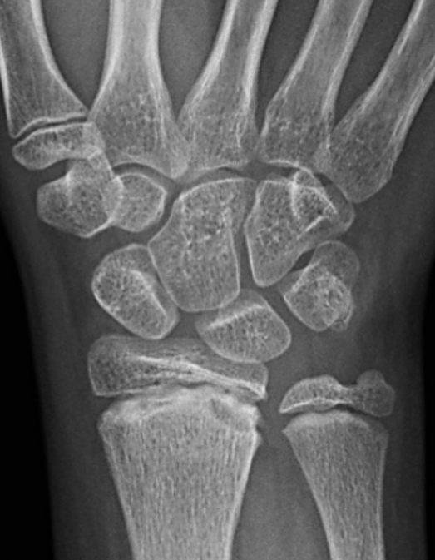
gymnast wrist
Risk factors: female sex, repetitive loaded activities with extreme wrist dorsiflexion
History: Dull radial wrist pain during the offending activity, usually relieved with rest.
Pain at rest is a sign of more severe injury.
Exam: TTP at the distal radial physis
3 stages based on xray changes:
Stage 1- symptoms, but no radiographic changes
Stage 2- characteristic xray changes
widening of the radial physis, cystic changes of the metaphysis
breaking of the distal aspect of the epiphysis, haziness within the physis
Stage 3- addition of changes in ulnar variance

Slide 44
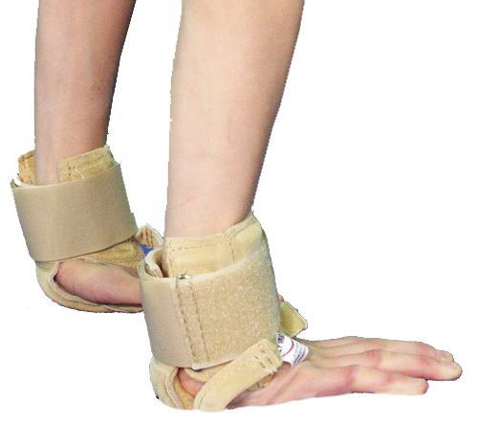
gymnast wrist
Treatment: rest from weight-bearing for at least 6 weeks
Rehabilitation: strengthening and proprioception training.
Gibson brace and a palm pad is recommended.
Surgery reserved for stage 3 injuries with positive ulnar variance and those at risk for physeal arrest.

Slide 45
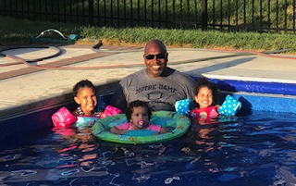
Thank you!

