Slide 1
Melissa Martinek, DO, PhD
Bio:
Pediatric Orthopaedic Surgery Attending at Dayton Children's
Graduated from Virginia College of Osteopathic Medicine
Orthopaedic Surgery Residency at University Hospitals Regional Medical Center, Richmond Heights, OH
Pediatric Orthopaedic Fellowship – St. Christopher’s Hospital for Children/Philadelphia Shriner’s Hospital
Board Certified - American Osteopathic Board of Orthopedic Surgery
“I chose Dayton Children’s because of the enthusiasm that exudes from the hospital and their focus on what matters; kids and their families.”

Slide 2
intoeing: the ins and outs
Melissa Martinek, DO, PhD
September 27, 2019

Slide 3
I have no disclosures pertaining to the following topics.

Slide 4
intoeing
One of the most common parental concerns for orthopaedic consult
Worried of permeant damage to the child
Will interfere with the child’s physical performance
Most cases are benign
Self resolving

Slide 5
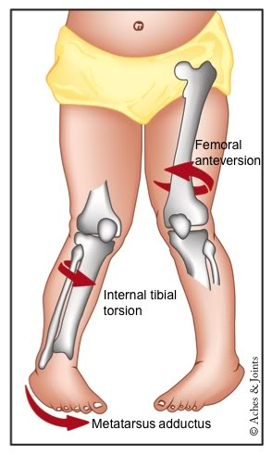
sources of benign intoeing
Femoral anteversion
Internal tibial torsion
Metatarsus adductus

Slide 6
benign intoeing
Most children resolve by age 5
Continue to improve with growth up to age 8-10 years
Early on can contribute to frequent tripping or falls
If residual present
Not a pain generator
Does not decrease speed
Does not increase risk of arthritis

Slide 7
worrisome intoeing
Static encephalopathy
Neurologic disorders
Mild tibial deficiencies
Infantile Blount disease
Metabolic bone disease
Skeletal dysplasias

Slide 8
key history
Neonatal history
Developmental history
Neurologic status
*while asking the parents/guardian questions allow the child to room around the room independently and be a silent observer

Slide 10
femoral anteversion
Angle of the femoral neck in relation to the femoral shaft in the coronal plane
Greatest in infancy and decreases with age
Infants 40 degrees
Adults 16 degrees
Gait
Patella is medially rotated and the foot is internally rotated.
Notes:
Figure: Degree of normal femoral torsion in relation to age.
The curve is the mean and the vertical lines represent the standard deviation

Slide 11
clinical features
Parents note the child trips
Intoeing is more prominent with running
Condition is not painful

Slide 12
Best seen in the prone position
External hip rotation
Internal hip rotation
Can also measure tibial torsion prone by the thigh foot angle

Slide 13
measurement of femoral anteversion
Simple
Clinical observation of the prominence of the greater trochanter
Patient prone and examiner internally rotates the hip until maximum prominence of the greater trochanter is palpated
Angle of internal rotation at that point is the femoral anteversion
Imaging
Under fluoroscopy
CT
MRI
Gait analysis
Was necessary when evaluating for surgical correction with gait deviations (Radler et al., 2010)

Slide 14
prognosis and natural history
Reduction of anteversion continues throughout growth
After 8 years of age there was no spontaneous correction femoral anteversion (Shands and Steele, 1959)
Does not increase risk of osteoarthritis (Hubbard and Staheli, 1988)
Female elite soccer player almost uniformly have excessive anteversion (Chiaia et al, 2009)

Slide 15
treatment
Careful education of the parents
Be available for recheck as the child grows
No known serious consequence from having excessive femoral anteversion

Slide 16
surgical treatment
Surgery is available for the rare cases where there is not improvement
15% percent complication rate
Indications
Child older than 8 years
Deformity severe enough with significant cosmetic and functional disability
Anteversion exceeding 50 degrees
Internal hip rotation > 85 degrees and external hip rotation <10 degrees
Family aware of the risks of the procedure
Femoral derotational osteotomy

Slide 17
internal tibial torsion
Turning in of the lower leg
Usually present at birth
Commonly seen as 12 mos when they start standing
Most common cause of intoeing from 3-4 years of age
Normal progression
Internal torsion with “unwind” to external torsion

Slide 18
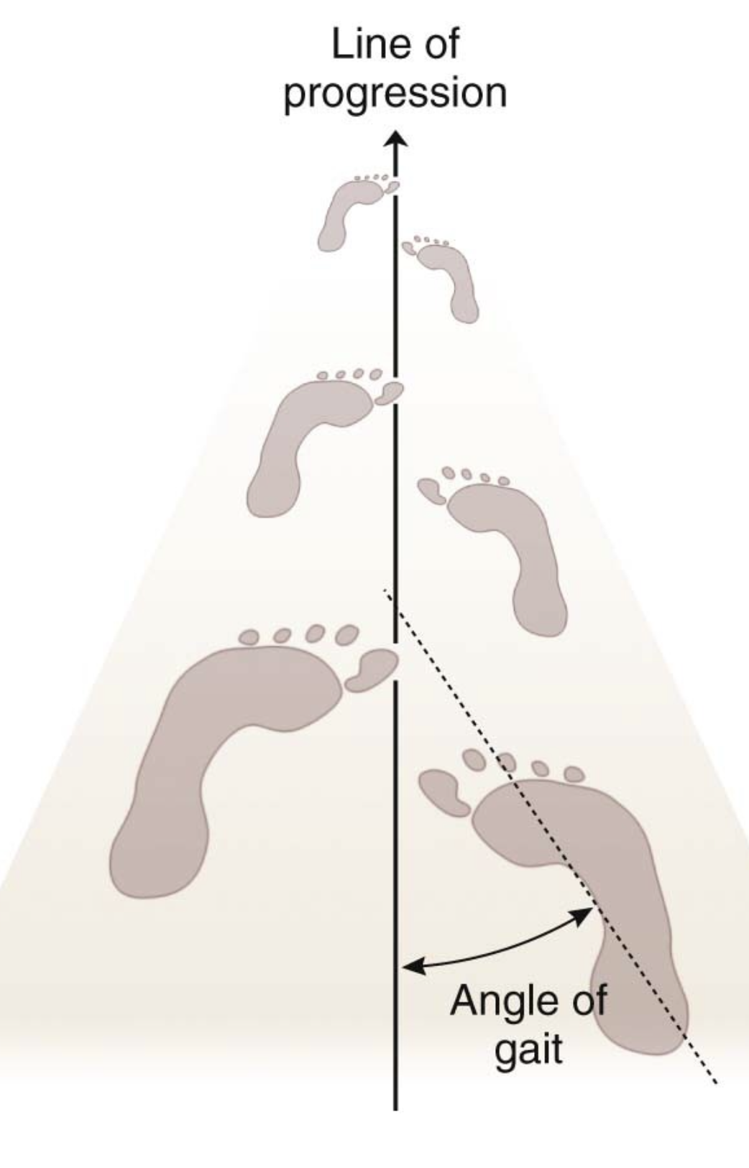

Slide 19
treatment
Brace or orthosis are ineffective and add to parents frustration
Rare cases may lead to derotational osteotomy
>8 years of age
Persistent functional of cosmetic problems
Internal rotation >15 degrees

Slide 20
metatarsus adductus
The forefoot is turned inwards
Flexible or Stiff
Flexible
Foot can be corrected with a stretch.
Usually resolved by the age of 3.
Stiff
May need some stretching cast
Continued rigidity may need surgical correction as the child ages
RARE

Slide 21
campaign to think twice before ordering that test
2018 AAP and POSNA

Slide 22
summary of intoeing
Very common in children
Frustrating for parents
Typically no pain or symptoms
Causes children to be clumsy
Natural progression is excellent
Non-operative treatment is unsuccessful
Very rarely is operative treatment needed

Slide 23
lower limb alignment
Genu varum
Genu valgum

Slide 24
bowed legs
Genu varum
Knees do not touch but the feet do
Normal in toddlers
Most common in those < 2 yrs
Rarely symptomatic in < 2 yrs

Slide 25
physiologic genu varum
Deformity of the tibiofemoral angle > 10 degrees of varus
A normal physis
Standing and walking the bowing becomes more prominent
Internal tibial torsion will increase the appearance

Slide 26
Maximum varum
6-12 mos
Maximum valgum
4 yrs

Slide 27
other causes
When it does not resolve as the child grows
Most Common is still physiologic genu varum
Etiologies
Rickets
Blount’s disease
Skeletal dysplasias
Obesity
Post-traumatic

Slide 28
Blount’s disease
Abnormality of the growth plate at the upper tibia
Initially may appear similar to physiologic genu varum but will not resolve by the age of 3
May need bracing
Not resolving by 4 may need surgical intervention
Growth modulation
Re-alignment osteotomy

Slide 29
knocked knees
Genu valgum
Knees touch but the ankles do not
Normal between ages 2-8 years
Maximum 2-4 years
After 8 years little to no change in alignment

Slide 30
causes of genu valgum
Idiopathic genu valgum
Secondary to trauma
Proximal tibia fracture “Cozen phenomena”
Spondyloepiphyseal and Metaphyseal dysplasias
Multiple Hereditary Exostoses

Slide 31
should my child see a dr.?
Greater than 2 years of age and not improving
Unilateral deformity
Older children
Having pain
Abnormal walking or running
Problems with sports

Slide 32
dr. exam
Questions
Development, nutrition,
family history
Rickets, skeletal dysplasia
Appearance of overall lower limb alignment
Examine hips, knees, and ankles
Prone and supine
Watch the child walk and run

Slide 33
other studies
X-ray
Concern for Blount’s disease or rickets
> 2 ½ years
Asymmetry in severity
Laboratory Studies
If concerned for Rickets
Calcium, phosphorus, vitamin D, alkaline phosphatase

Slide 34
treatment
MOST need no intervention
Bow legs correct age 3-4 years
Knock knees correct age 6-7 years
Blount’s disease
Braces
Surgical correction by age 4
Growth modulation
Re-alignment
Rickets
Medication
If not correct with medication then may need surgical intervention
Older children with continued Genu Varum/Valgum
Growth modulation
Osteotomy with re-alignment

Slide 35
skeletally immature
Growth Modulation
Hemiepiphysiodesis

Slide 36
skeletally mature
Realignment Osteotomy

Slide 37
review

Slide 38
questions???

Slide 39
resources
Johnston, C.E., Young, M. Tachdjian’s Pediatric Orthopaedics : From the Texas Scottish Rite Hospital for Children. Disorders of the leg.pp713-760.
orthokids.org
http://orthokids.org/Condition/Bowed-Legs-Knock-Knees 9/8/2019
http://orthokids.org/Condition/In-Toeing 9/8/2019
https://orthoinfo.aaos.org/en/diseases--conditions/bowed-legs-blounts-disease

