Slide 1
Claire Beimesch, M.D.
Bio:
Graduate of Xavier University and the University of Kentucky College of Medicine
Orthopaedic Residency at West Virginia University and Fellowship at Gillette Children’s Specialty Healthcare where she first became interested in gait and motion analysis
Specializes in gait analysis and cerebral palsy
“I like working with kids because
they are unlimited sources of joy and potential!”

Slide 2
disclosure
I have no disclosures related to the following topic.

Slide 3
Common Fracture Patterns in the Office Setting
Claire F. Beimesch, MD
Pediatric Orthopaedic Surgeon
Dayton Children’s Hospital

Slide 4
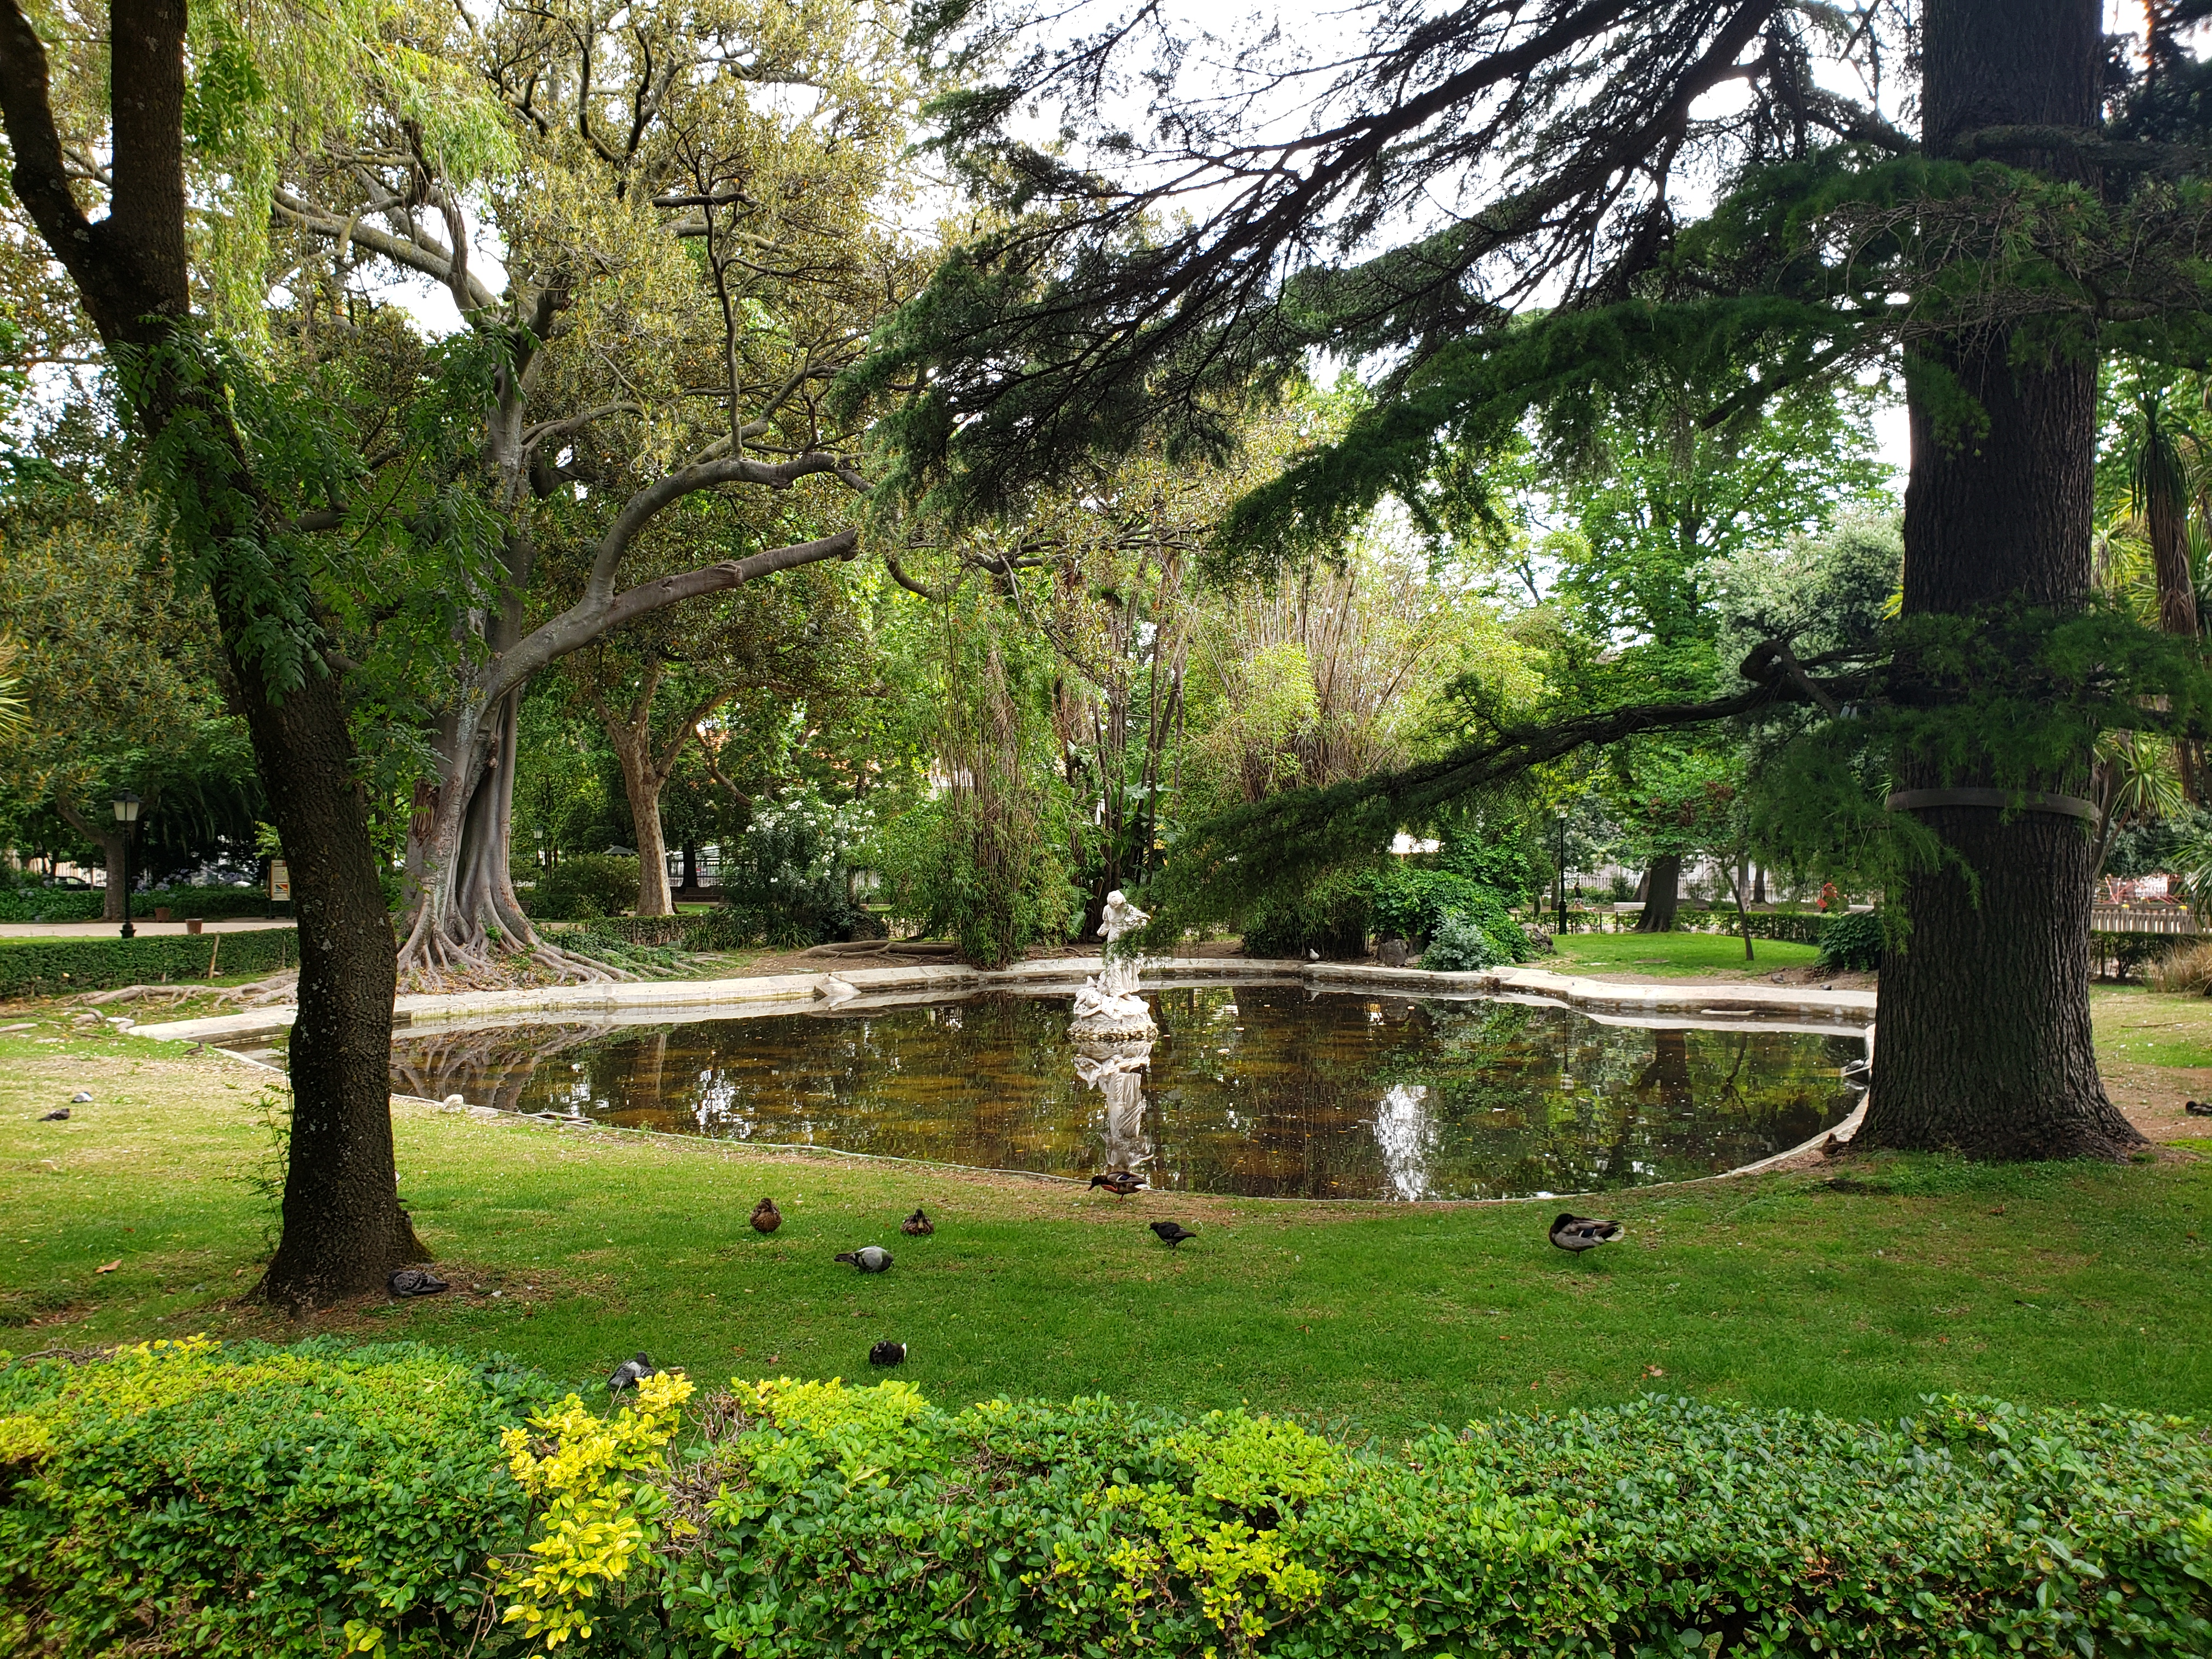
Our goal
What fractures can be safely treated:
Nonoperatively
Non procedurally (without a reduction)
With oral pain medication
Without serial neurovascular checks

Slide 5
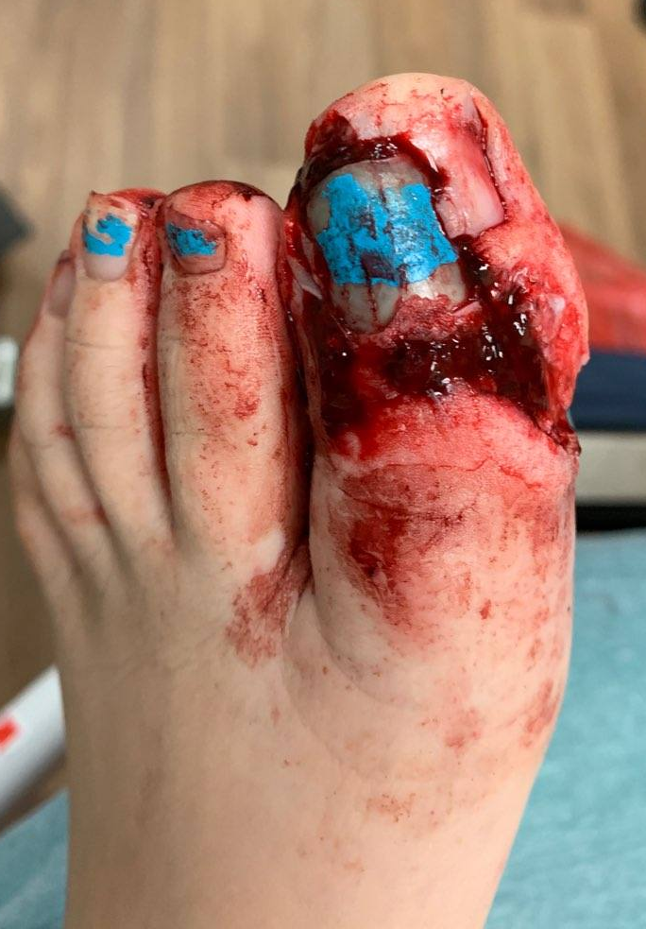
That eliminates:
Open Fractures
Fractures with a neurovascular abnormality
Fractures with an obvious deformity
Patients with uncontrolled pain

Slide 6
Big Players
Distal Radius Buckle Fractures
Finger Fractures
Fractures of the Carpus
Type 1 supracondylar humerus fractures
Proximal humerus fractures in younger children
Clavicle fractures
Toddler’s fractures & Cozen fractures
Nondisplaced Salter-Harris 1 distal fibula fractures
Foot Fractures

Slide 7
Big Players
Distal Radius Buckle Fractures
Finger Fractures
Fractures of the Carpus
Type 1 supracondylar humerus fractures
Proximal humerus fractures in younger children
Clavicle fractures
Toddler’s fractures & Cozen fractures
Nondisplaced Salter-Harris 1&2 distal fibula fractures
Foot Fractures

Slide 8
Distal Radius Buckle/Torus Fracture
Most common fracture seen in pediatric orthopaedic clinics
Incomplete fracture of distal radius proximal to the physis
Stable fracture pattern that will heal reliably without growth arrest
Previously universally treated in a short arm cast
Treatment has trended towards in a removable wrist brace or a cast, depending on patient age, compliance, and activity level

Slide 9
Distal Radius Buckle/Torus Fractures: Yes or No?
Does not involve the growth plate (Salter Harris I or II fracture)
Can involve the volar or dorsal cortex
Does not technically involve the volar cortex also (Buckle +/greenstick, Colles’ fracture)
Does not involve the ulna (different ICD-10 code, but treated the same)
Does not need reduction (as some greenstick fractures do)

Slide 10
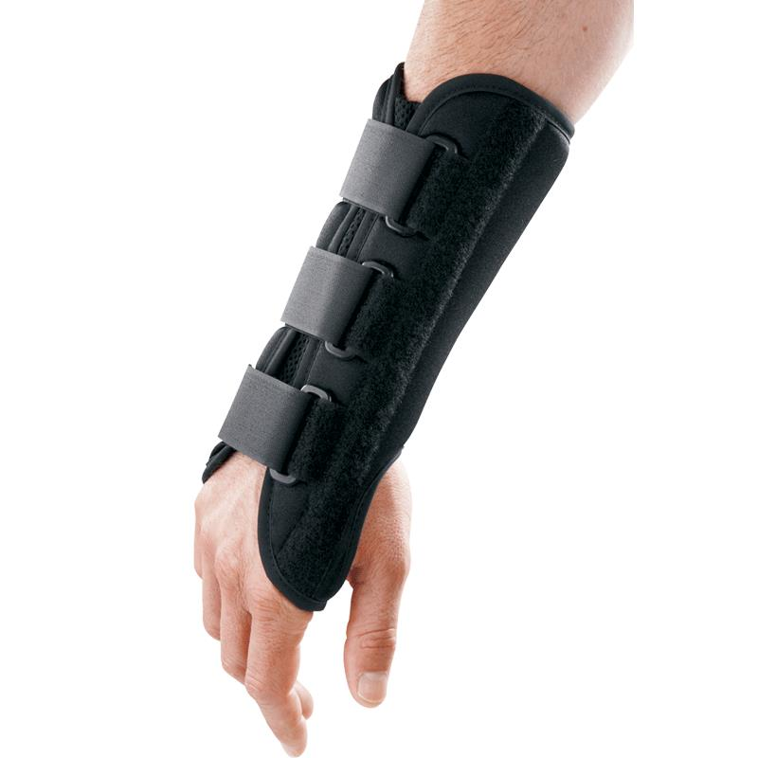
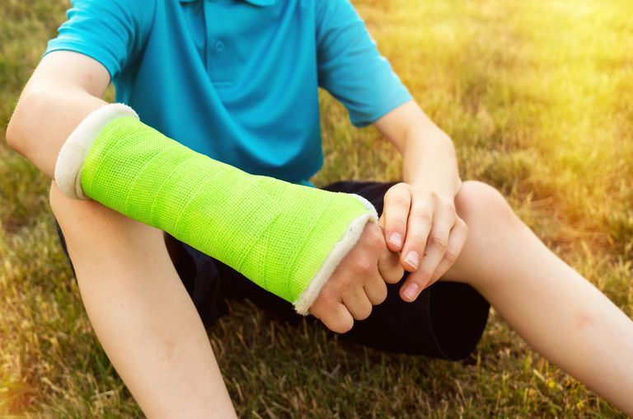
Distal Radius Buckle/Torus Fractures: My treatment algorithm
What I tell parents
Stable fracture pattern-will heal reliably
Needs 3-4 weeks of immobilization
Does NOT need a repeat X-ray
Does NOT need surgery or a reduction
Proximal to the physis, so NOT a growth plate fracture
How I treat kids:
3 weeks for kids <8, 4 weeks for kids >8
Wrist brace for the compliant, lower-energy kid who will keep a brace on full-time except for bathing
Short arm cast for the non-compliant, more active kid (majority of kids)
Long arm cast for kids under 4 or 5
I allow kids to play in SAC
RTC 3-4 weeks for clinical check out of immobilization
Brace for activities only depending on comfort (bike, gym, sports, etc)

Slide 11
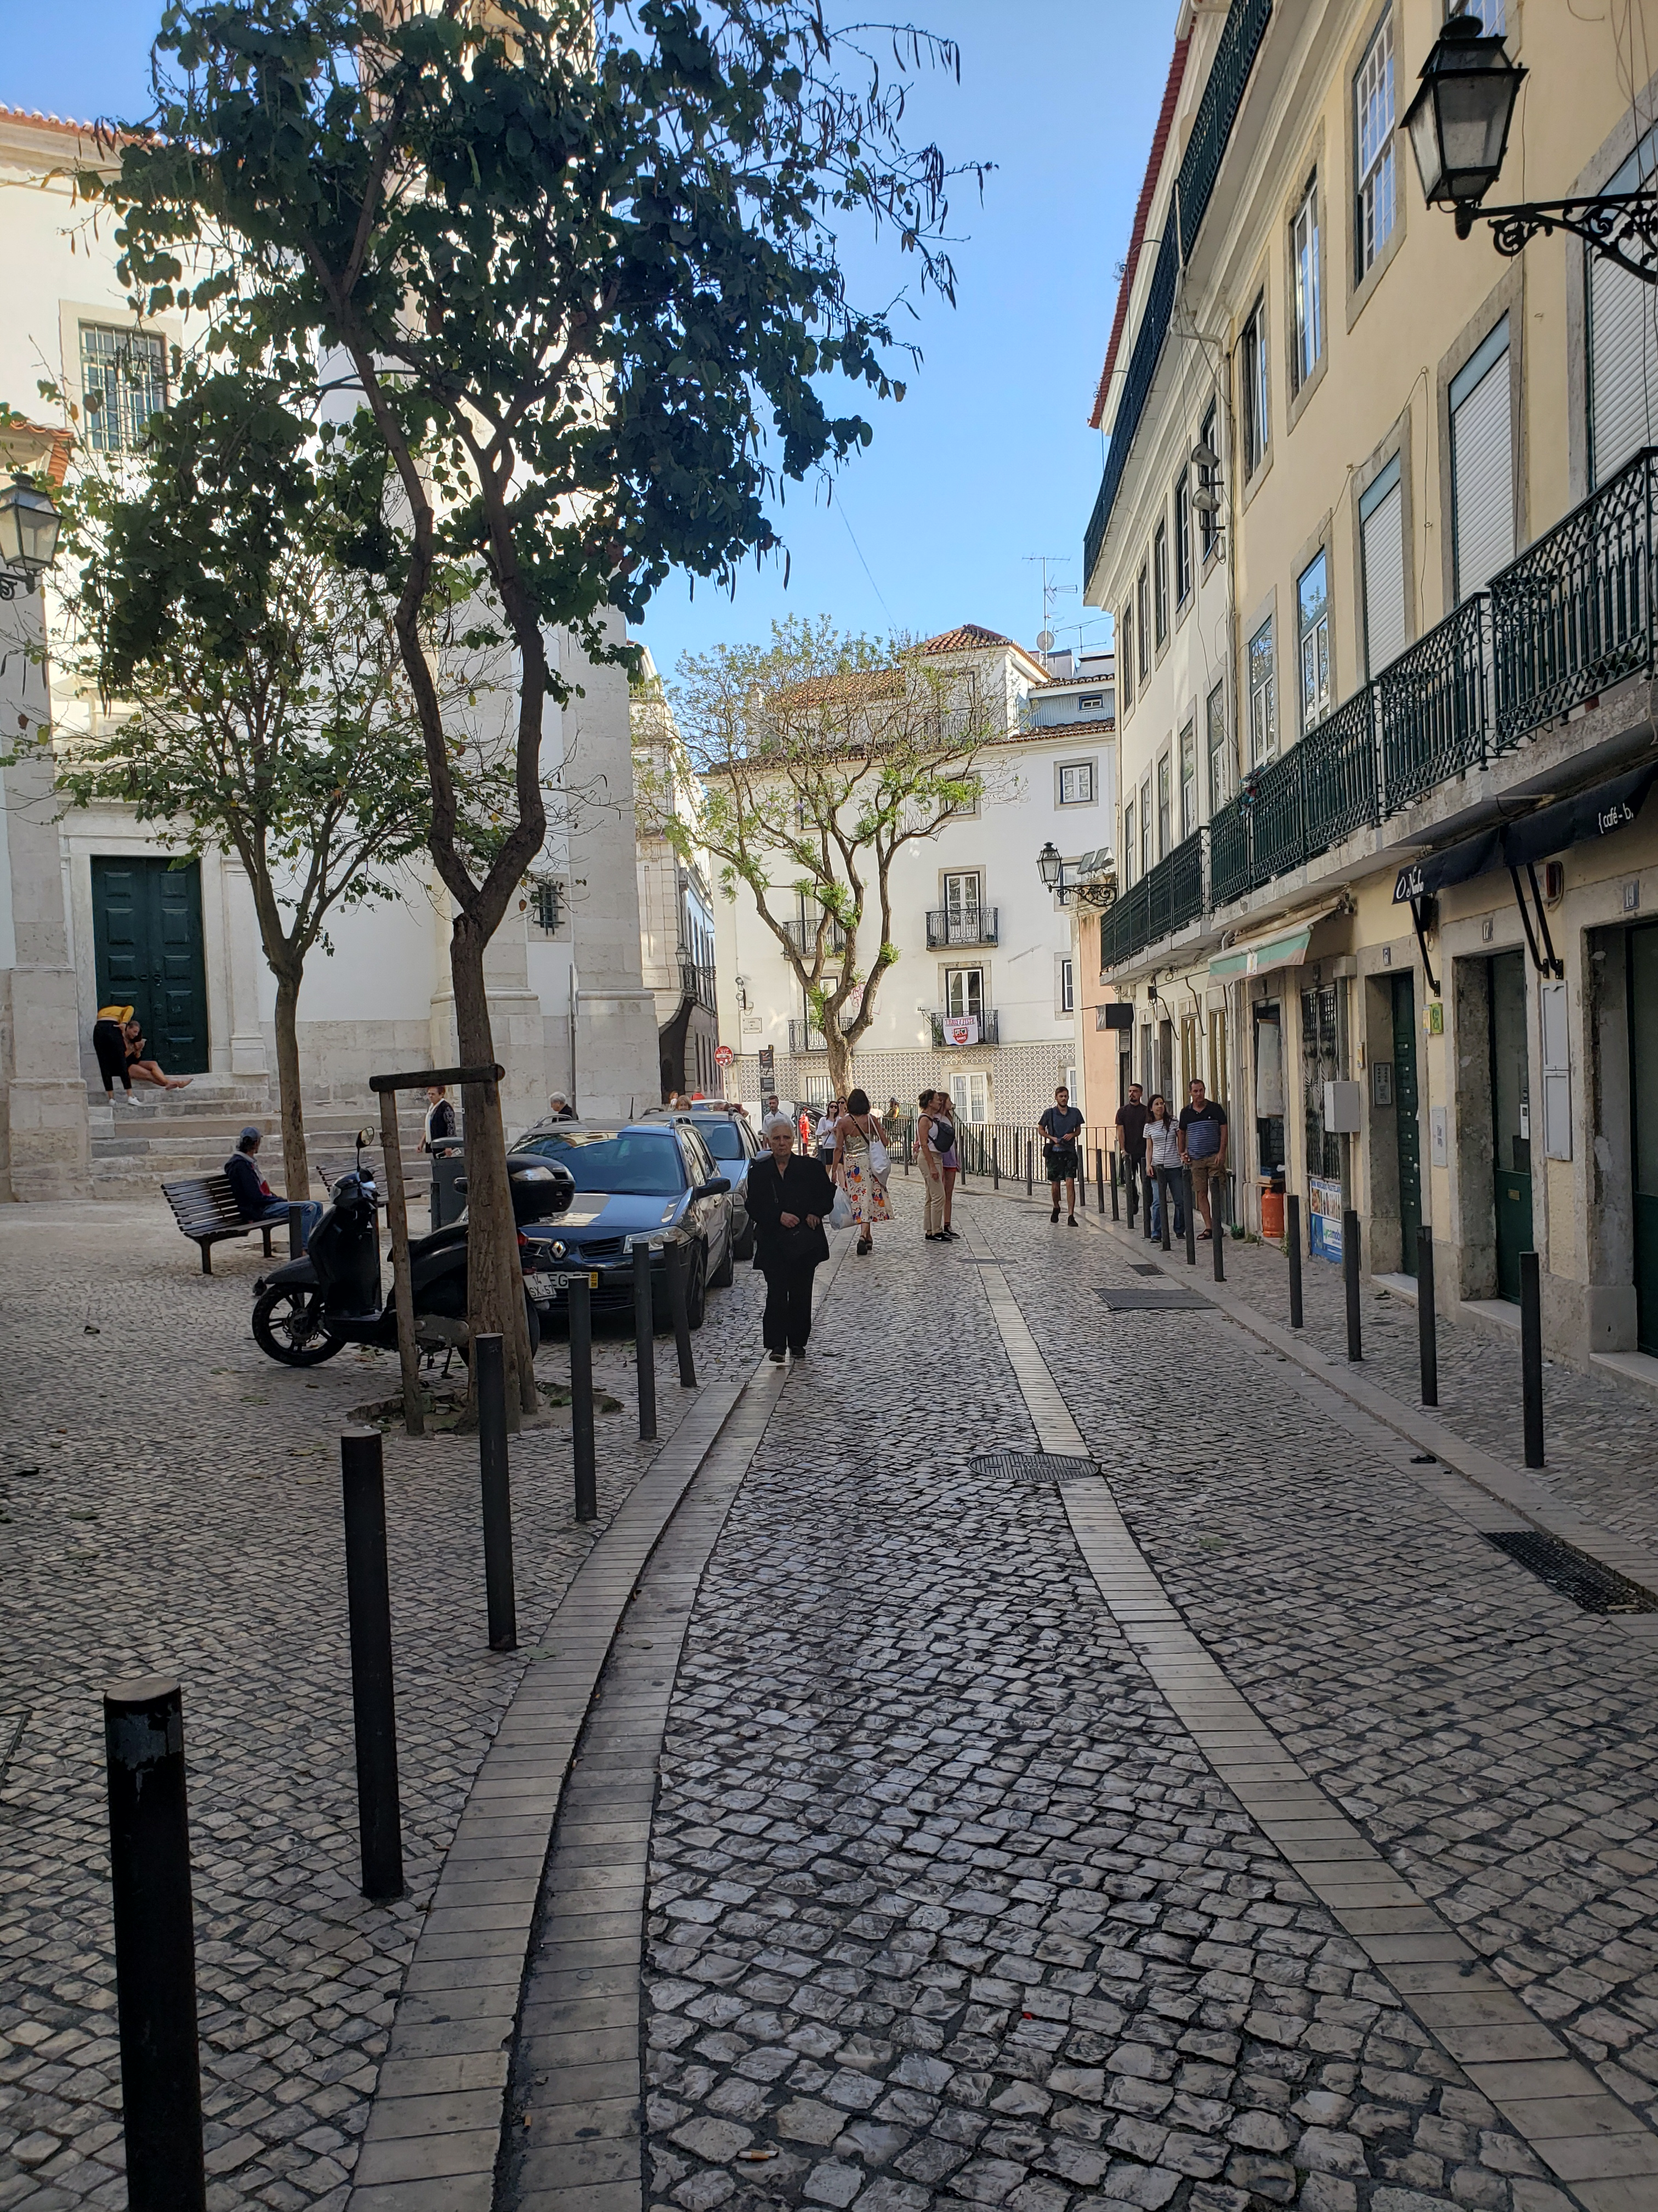
Type 1 supracondylar humerus fractures
Gartland classification
Most common elbow fracture in children
Non displaced fracture proximal to elbow joint, above the physis
Type 1-nondisplaced, Type 2-partially angulated fracture, Type 3- totally displaced fracture
Anterior humeral line should bisect the capitellum in Type 1
Treated with long arm casting for 3-5 weeks

Slide 12
Type 1 supracondylar humerus fractures: Yes or No?
Lateral condyle fractures
Radial Head/Neck Fractures
Medial epicondyle fractures
Lateral epicondylar avulsion fracture

Slide 13
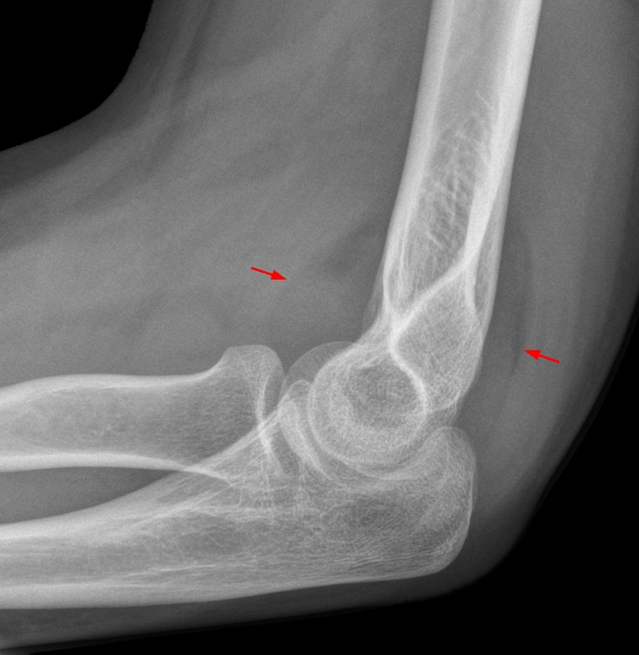
Type 1 Supracondylar Humerus Fractures: Fat pads & Sails
Swelling around elbow joint
Can be anterior or posterior
Anterior can be normal or indicative of a fracture
Posterior can be only indication of an occult fracture

Slide 14
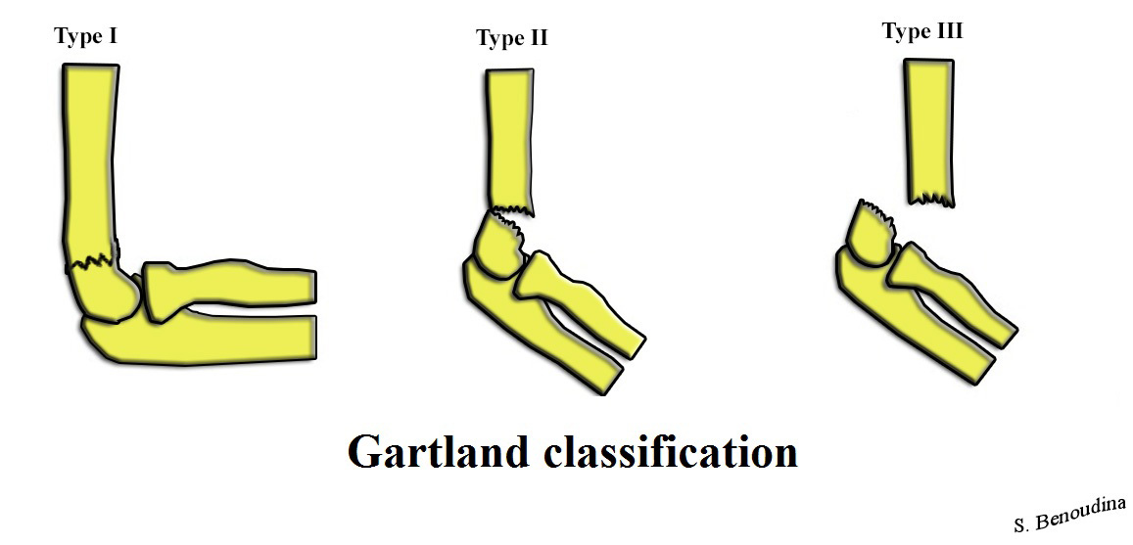
Type 1 Supracondylar Humerus Fractures: Gartland Classification

Slide 17
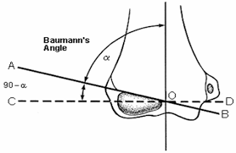
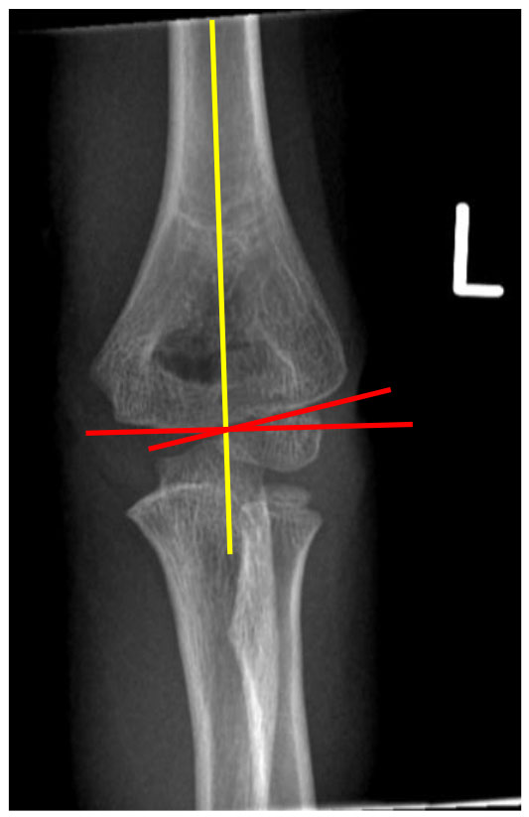
Type 1 Supracondylar Humerus Fractures: Baumann’s Angle
Angle made between 90 degrees from line drawn down the shaft of humerus and angle of physis
Normal 70-75 degrees
Comparison view sometimes helpful
Can indicate subtle comminution which indicates more than a Type 1 fracture

Slide 18
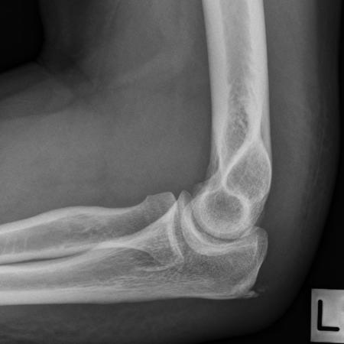
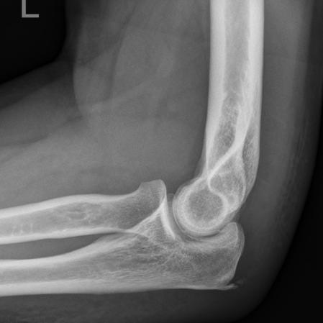
Type 1 supracondylar humerus fractures: My treatment algorithm
Verify lateral X-ray is adequate
Verify no comminution on AP view (Baumann’s angle)
Assess swelling at the elbow-if significant swelling or ecchymosis, is the X-ray misleading?
Long arm cast at 90 degrees of flexion for 3-5 weeks
I mold a dimple or depression into the olecranon fossa to prevent elbow extension and recreation of fracture defect (pistoning within cast)
If there is no definitive fracture line but an elbow effusion, I cast for 10-14 days and re-examine depending on clinical exam

Slide 19
Proximal humerus fractures
80% of humeral growth comes from the proximal humeral physis
This means that the majority of proximal humerus fractures can be treated nonoperatively due to its tremendous remodeling potential
The younger the patient, the greater the remodeling potential

Slide 20
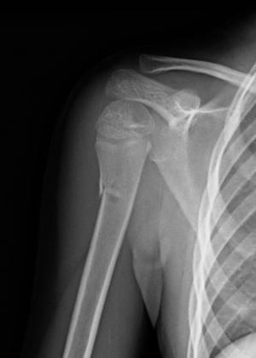
Proximal Humerus Fractures: My treatment algorithm
Pin the onesie sleeve to the onesie for 1-2 weeks in newborns
Sling for young children if they can tolerate it for 2-4 weeks
Gradual resumption of activities over 2-6 week period

Slide 21
Clavicle fractures
Clavicle fractures previously were universally treated nonoperatively
COT study from 2010 noted better functional outcomes when clavicle fractures with < 2 cm of shortening were treated operatively
However, the majority of pediatric clavicle fractures still do not require surgery!

Slide 22
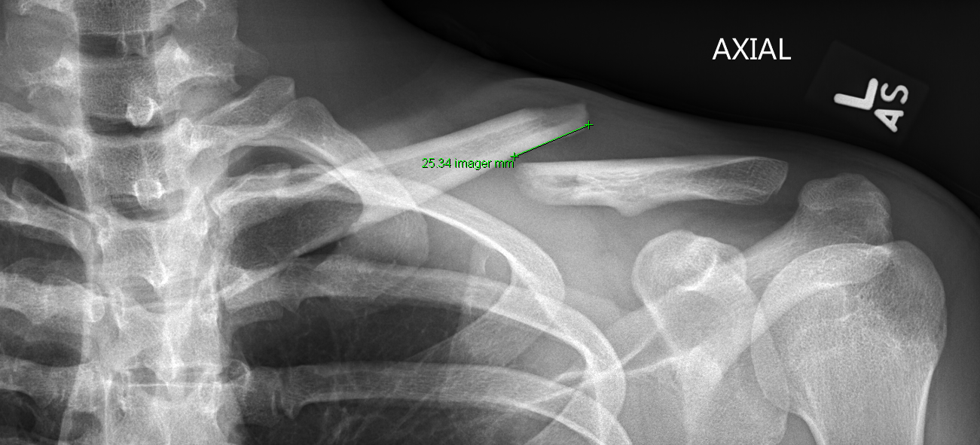
Clavicle Fractures: Operative Treatment
Adolescent and/or skeletally mature
Dominant arm
Throwing or high intensity athlete
> 2 cm of shortening

Slide 23
Clavicle Fractures: My treatment algorithm
If the patient is skeletally immature:
Sling while outside the house x 4 weeks
Pendulum exercises starting at 1-2 weeks from injury
Abduction to level of shoulder at 3-4 weeks postinjury
X-ray at 4 weeks (AP, Axial Clavicle)
No contact sports for 6 weeks
No gymnastics for 6-12 weeks, with gradual return to sport over 6 weeks
Warn parents about the fracture callus bump!

Slide 24
Clavicle Fractures: My treatment algorithm
If the patient is adolescent or skeletally mature:
Assess X-rays for 2 cm of shortening or less
If < 2 cm short, I may reimage in 1 week to assess change in alignment
If > 2 cm short, will discuss operative intervention (ORIF with plate)
If involves distal end at AC joint, I will usually operate

Slide 25
Toddler’s fractures: The Facts
Non displaced spiral tibial shaft fracture
No associated fibula fracture
Child < 2.5 years of age
Low-energy twisting mechanism common
Clinical diagnosis as well as radiographic (fracture line only visible part of the time)

Slide 26
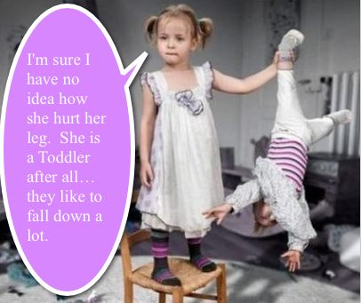
Toddler’s Fractures: The Exam
Child usually pointing to knee or below
Tenderness to palpation over tibia versus generalized stranger anxiety
Bruising/Swelling
Refusal to weight bear versus toe walking, lateral border walking, or crawling

Slide 27
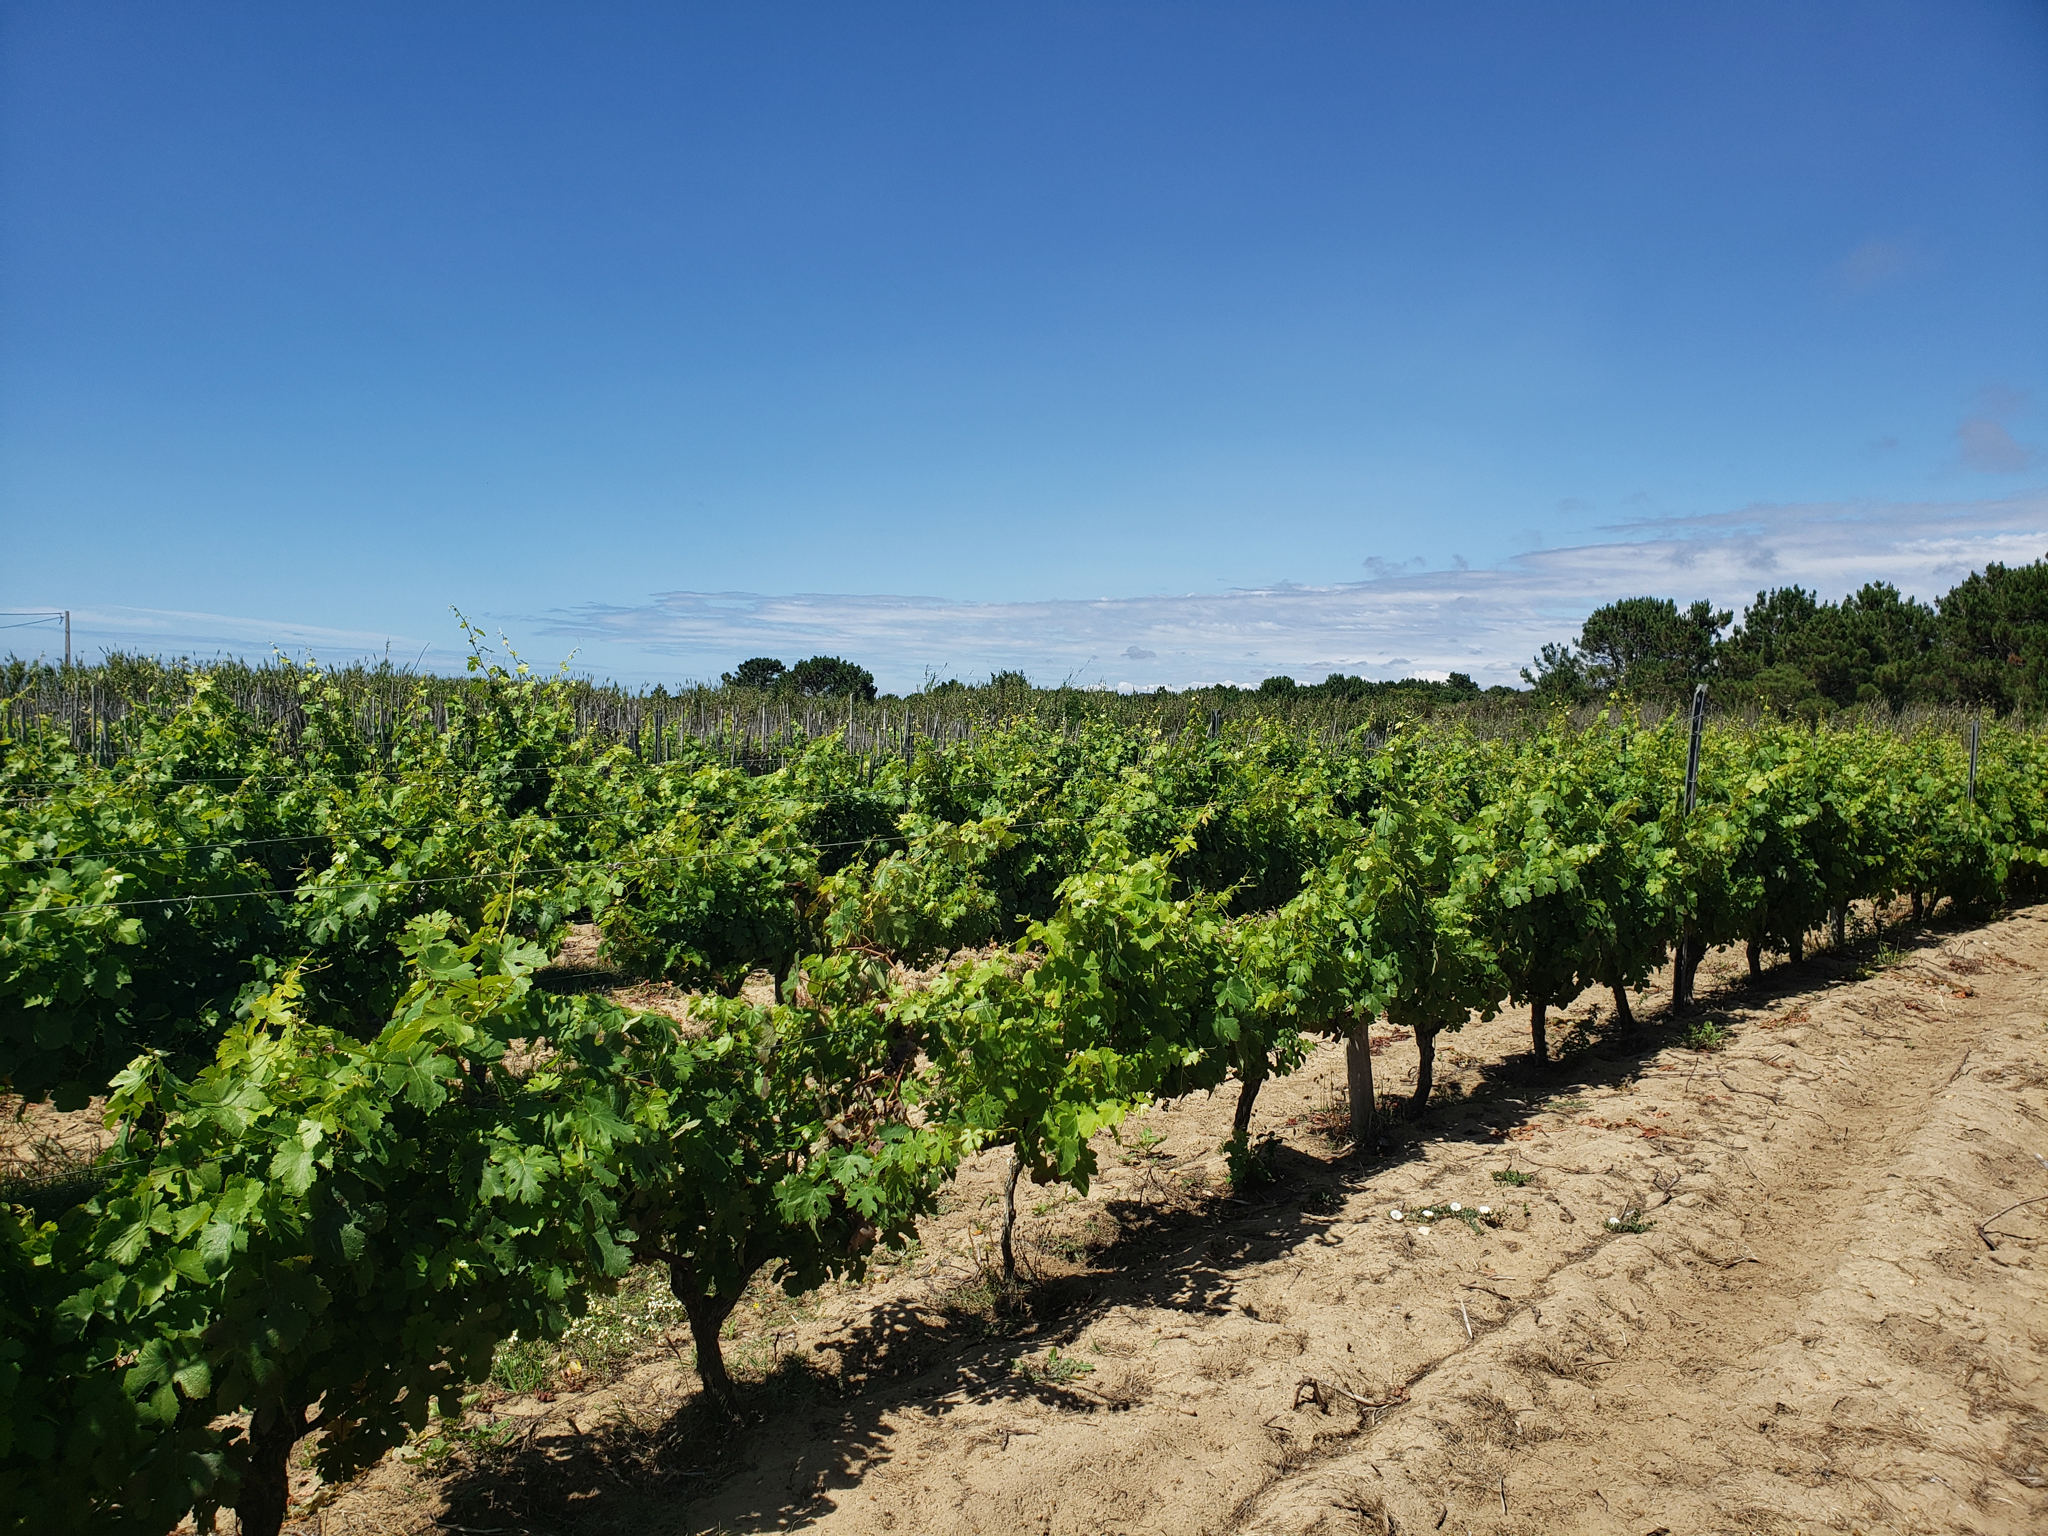
Toddler’s fracture: My treatment algorithm
Assess ability to weight bear and time from injury
If patient is unable to weight bear or actively limps, question about concern for other diagnoses (septic joint, rheumatologic issue, etc.)
If trauma is inciting event, likely is a non-displaced toddler’s fracture
I cast these for 2-4 weeks in long leg, bent knee cast
Patient is allowed to weight bear as they tolerate
Will reexamine out of cast in 2-4 weeks. No repeat radiographs.

Slide 28
Cozen Fracture
Nondisplaced proximal tibial shaft fracture
Low energy mechanism typically
Can have a fibula fracture, but usually
Higher energy mechanism

Slide 29
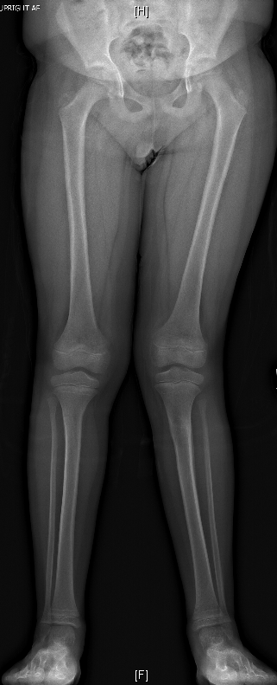
Cozen phenomenon
Gradual valgus angulation after a proximal tibial fracture
For toddler’s fractures, almost universally resolves
May take 12-24 months
I offer family choice of follow up in 6 months or they can call

Slide 30
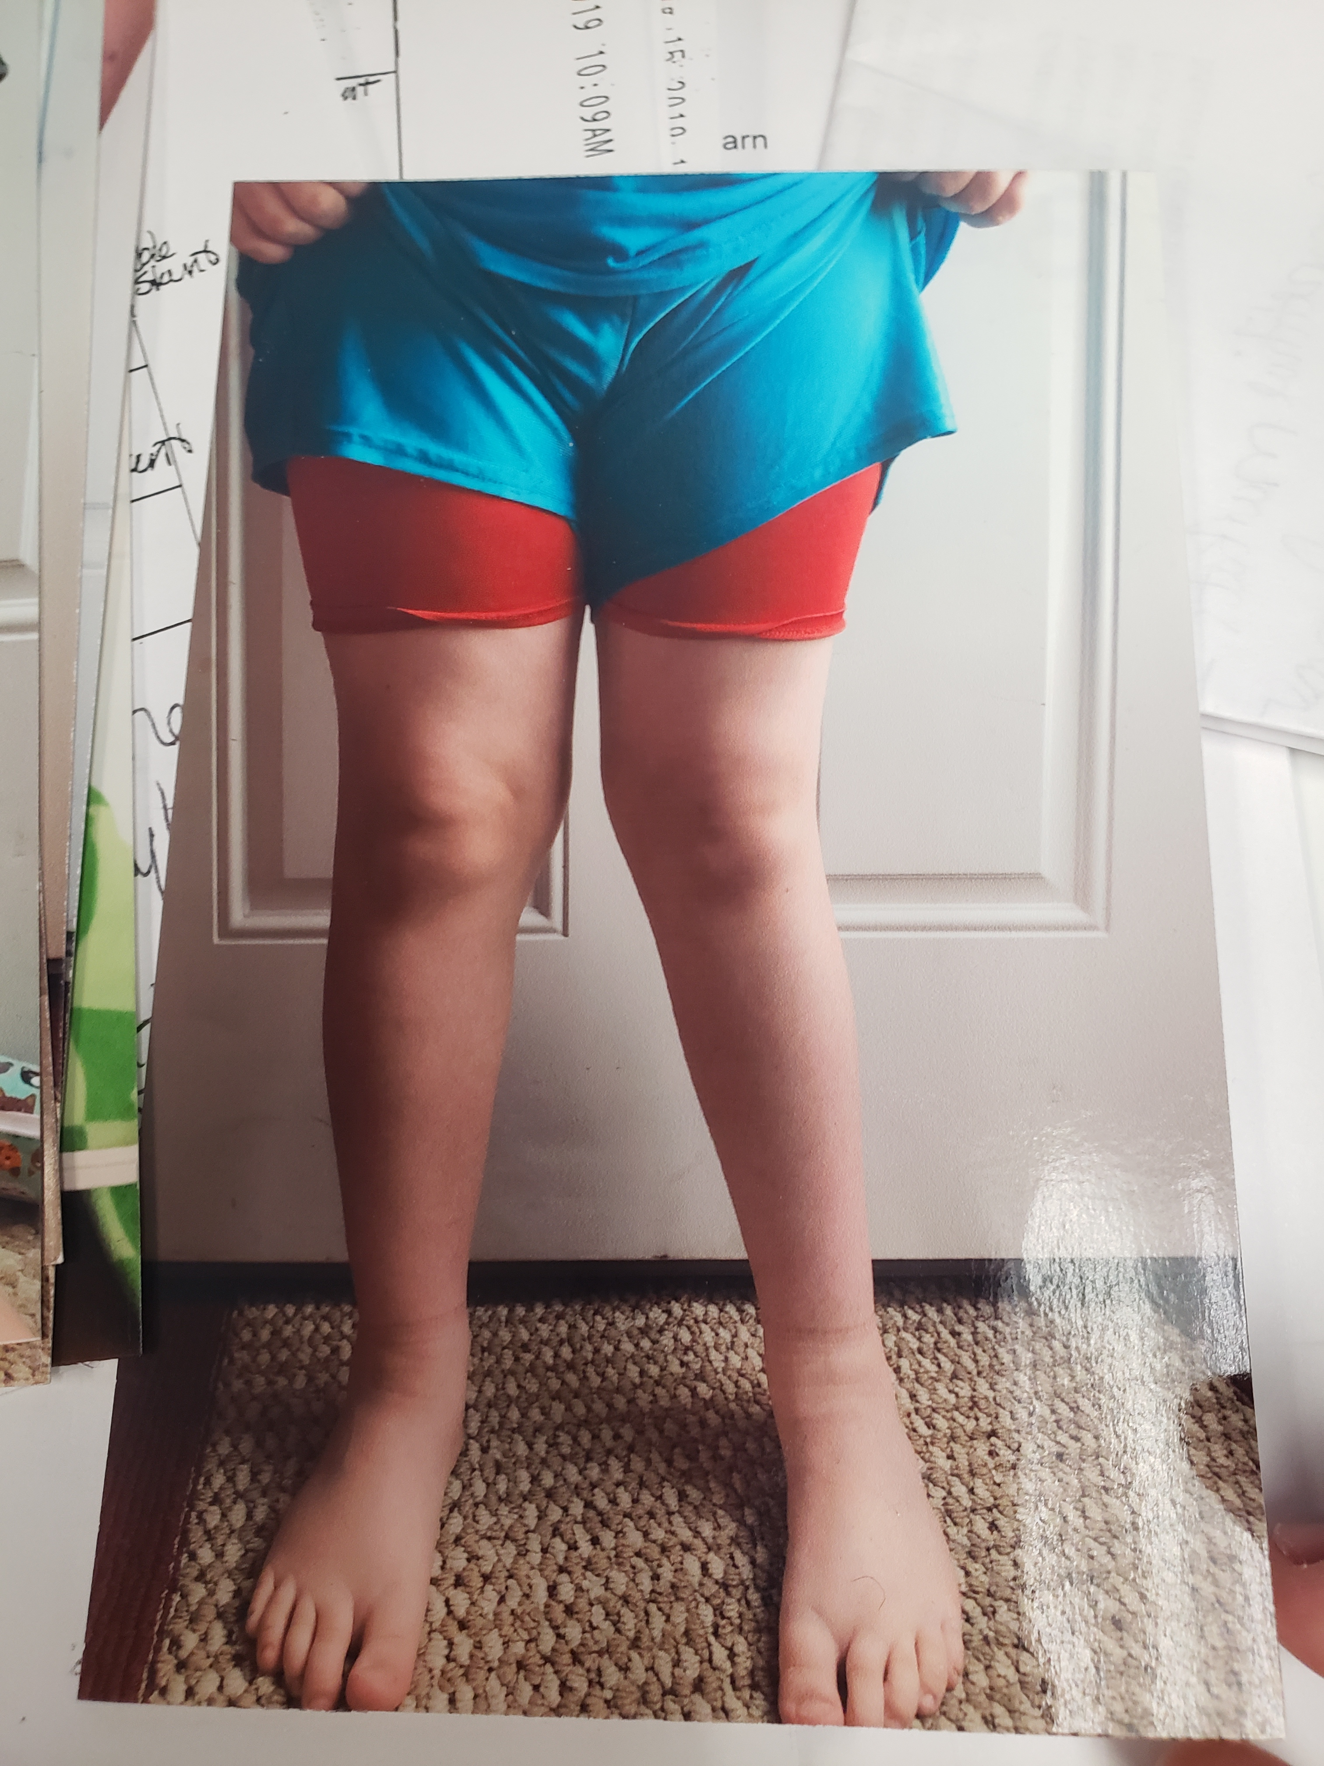
Cozen fracture: My treatment algorithm
Long leg bent knee cast for 4 weeks
Patient may advance weight bearing as they tolerate
Knee immobilizer for 2-4 weeks
Discuss Cozen phenomenon
6 month follow up versus patient call if valgus alignment becomes apparent

Slide 31
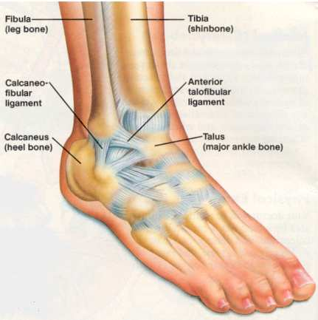
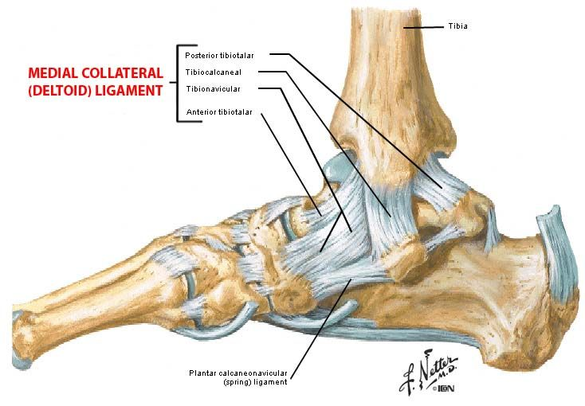
Nondisplaced Salter-Harris 1&2 distal fibula fractures
Nondisplaced fracture through the distal fibular physis (with metaphyseal component in SH2)
Low risk of growth arrest
Can be clinically and radiographically indistinguishable
from ankle sprain (in the cast of SH1)

Slide 32
Nondisplaced Salter-Harris 1&2 distal fibula fractures
Safe to treat both SH1 distal fibula fractures and significant ankle sprains in a CAM boot or short leg weight bearing cast for 4 weeks
I distinguish on exam and in documentation location of tenderness to palpation (ATFL, CFL, distal fibular physis) as well as amount of swelling, ecchymosis, ability to weight bear, and time since injury
Discuss with family that if fracture is non displaced, distinguishing between these entities is not always clear but treatment is the same
Will recheck in 3-4 weeks and advance out of boot/cast at that time

Slide 33
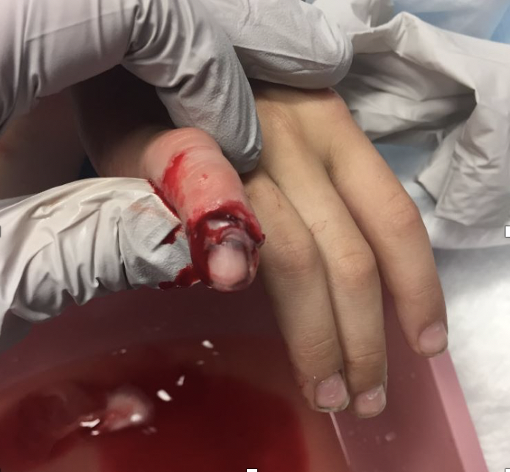
Finger & Toe Fractures
Clinical exam is key for treatment-Angulation can remodel, articular stepoff and rotation cannot!
Look at the nailbed-is the fracture really open?

Slide 34
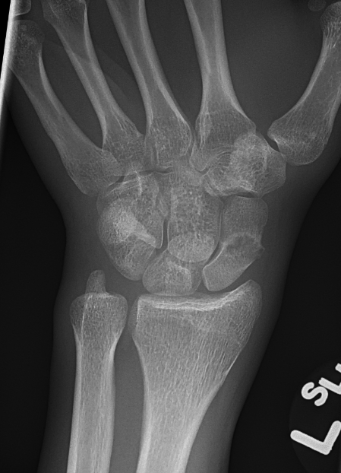
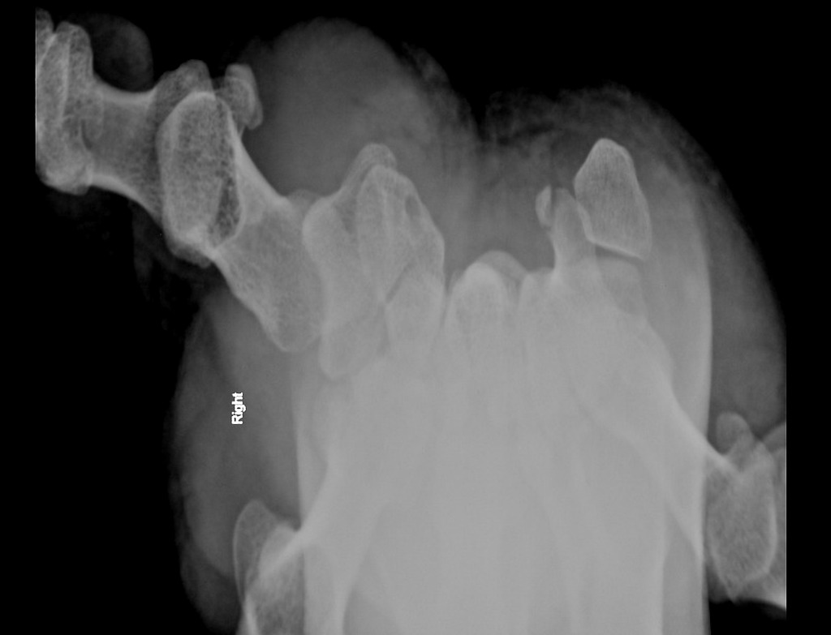
Carpal Fractures
Most non displaced fractures of the carpus heal uneventfully
Exception: Scaphoid fractures have some of the highest nonunion rates of any fracture we treat in children or adults
Sometimes hamate hook fractures go on to nonunion and must be excised; more common in high impact athletes (gymnasts)

Slide 35
Thank you! Questions?

